Slide 1

System Design Review Mission Exploration and Research of Venus (MERV)
ARO 4821L-02
March 28th, 2024
Notes:
Script
Good day everyone, I hope you’re doing tremendously well today.
Firstly, I want to thank you for giving us some time out of your day to hear our presentation.
We’re MERV (Mission Exploration and Research of Venus), a group of Cal Poly Pomona Aerospace Engineering students

Slide 2





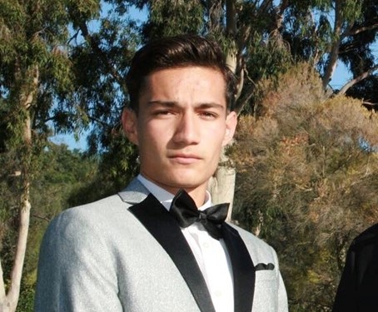
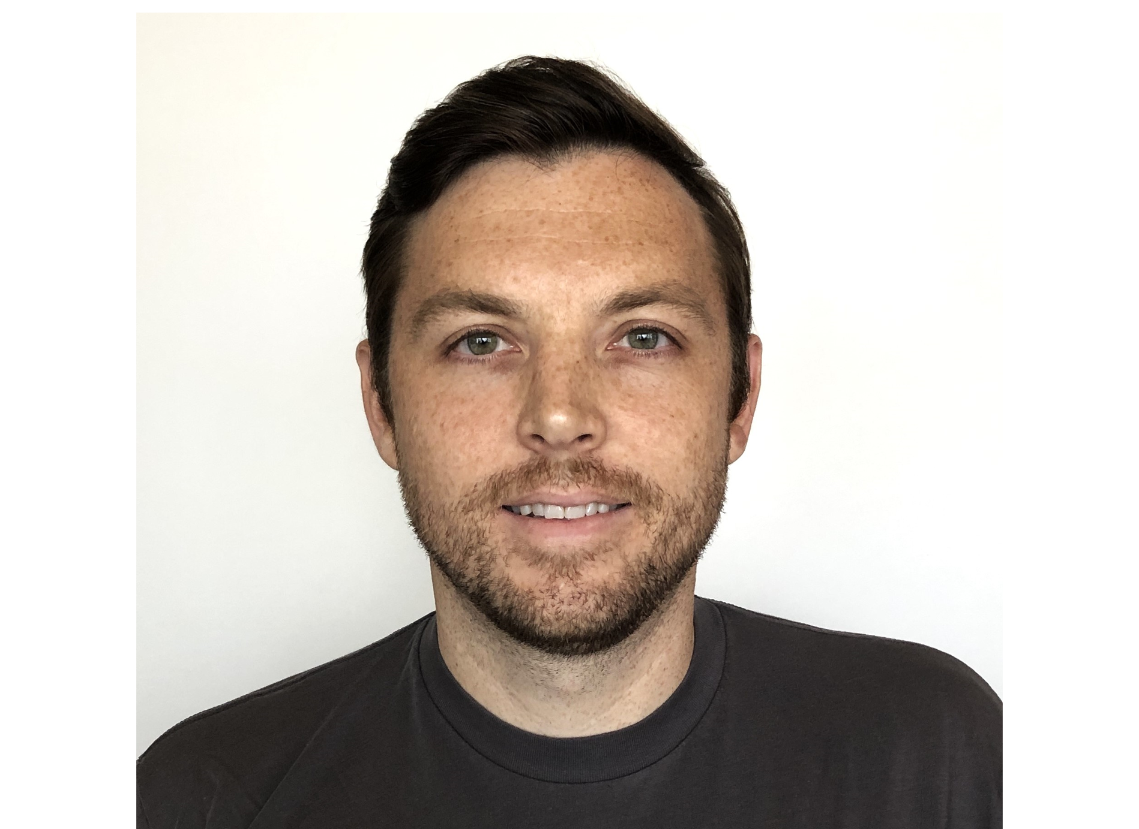




Project
Deputy
ADCS
COMMS
Systems Engineering
Payload
Structures
Thermal
Trajectory
Propulsion
Eric Ruf
Alejandro Wuence
JD Morrisey
Alejandro W.
Eric R.
Harold Hernandez
Francisco Sanudo
Rene J. Holmes II
Eric Lead
Alton Lo
Peter Ho
Deputy
Project Manager
Francisco S.
Michael Q.
Eric R.
Peter H.
Harold H.
Rene H.
Francisco S.
Rene H.
Michael Q.
Peter H.
Rene H.
Francisco S.
Rene H.
Eric R.
Rene H.
Peter H.
Team
2

Slide 3
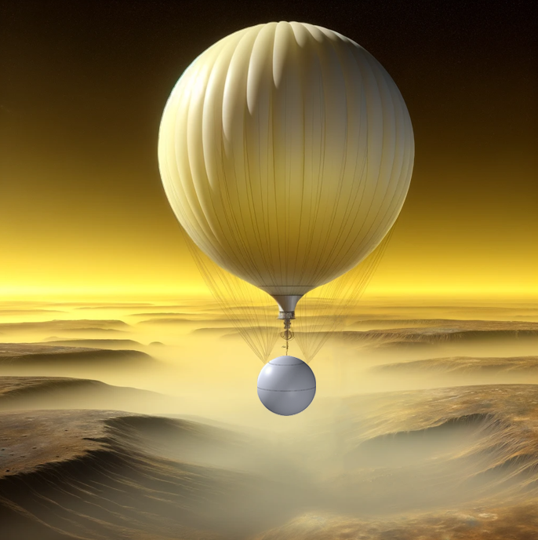
Introduction
Design Overview
Architecture & Schedule
Concept-of-Operations
Analysis
Trade Studies
Mass & Power Statements
Conclusion
Michael Quach

Slide 4
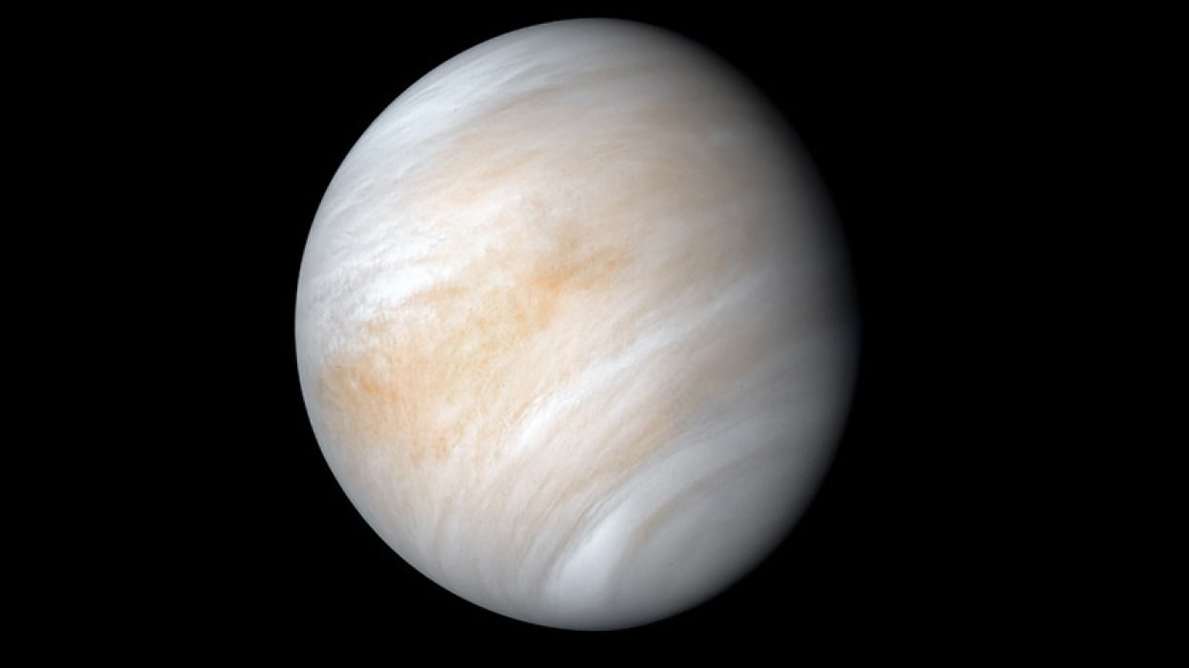
Design Overview
Michael Quach

Slide 5
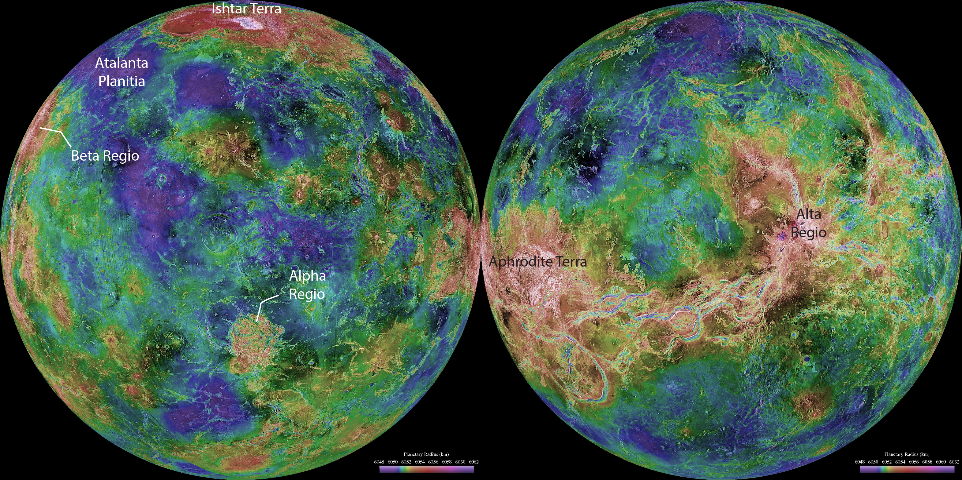
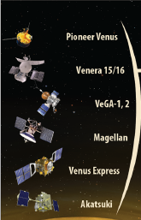
Mission Overview
Key Objectives
Robotic mission supported by crew of 4 orbiting around Venus to collect scientific data for a max mission duration of 30 days
Crew interaction during all phases of the mission
Complete spacecraft design within $1 Billion (FY23) including operation costs however, the crew costs are out of the scope of this RFP
Launch no later than December 31, 2037
Scientific Goals
Determine the atmospheric composition and structure of the Venusian crust and mantle
Cloud composition and noble gases
Analyze the composition of the Venusian atmosphere using Genesis and VIRA
Alpha Regio
Courtesy:
NASA
Michael Quach
Notes:
Control inputs, EDL, and other jazzers

Slide 6
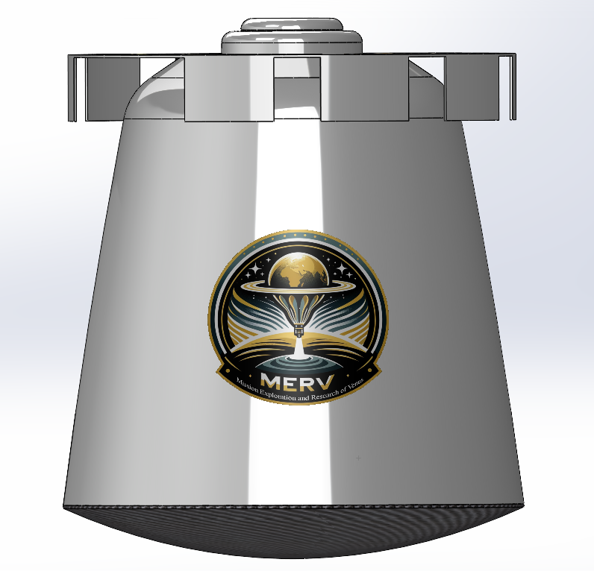
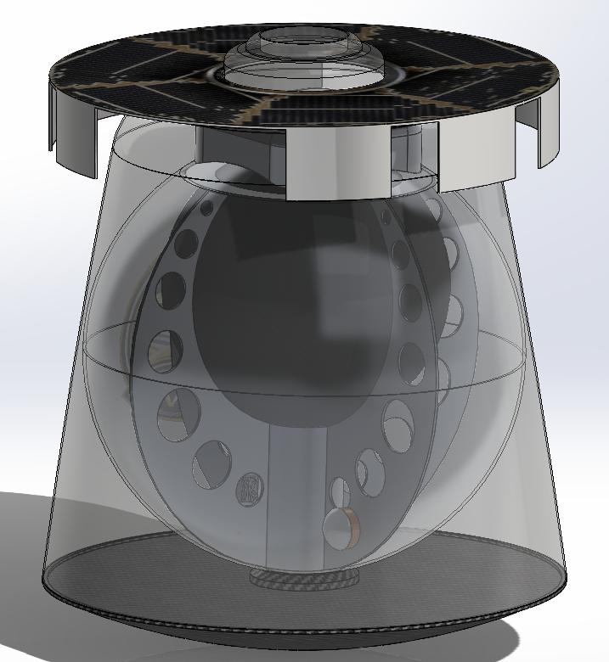
Current Architecture
Cruise stage
Hydrogen tank
Back shell
Gondola
Heat shield
JD Morrissey

Slide 7
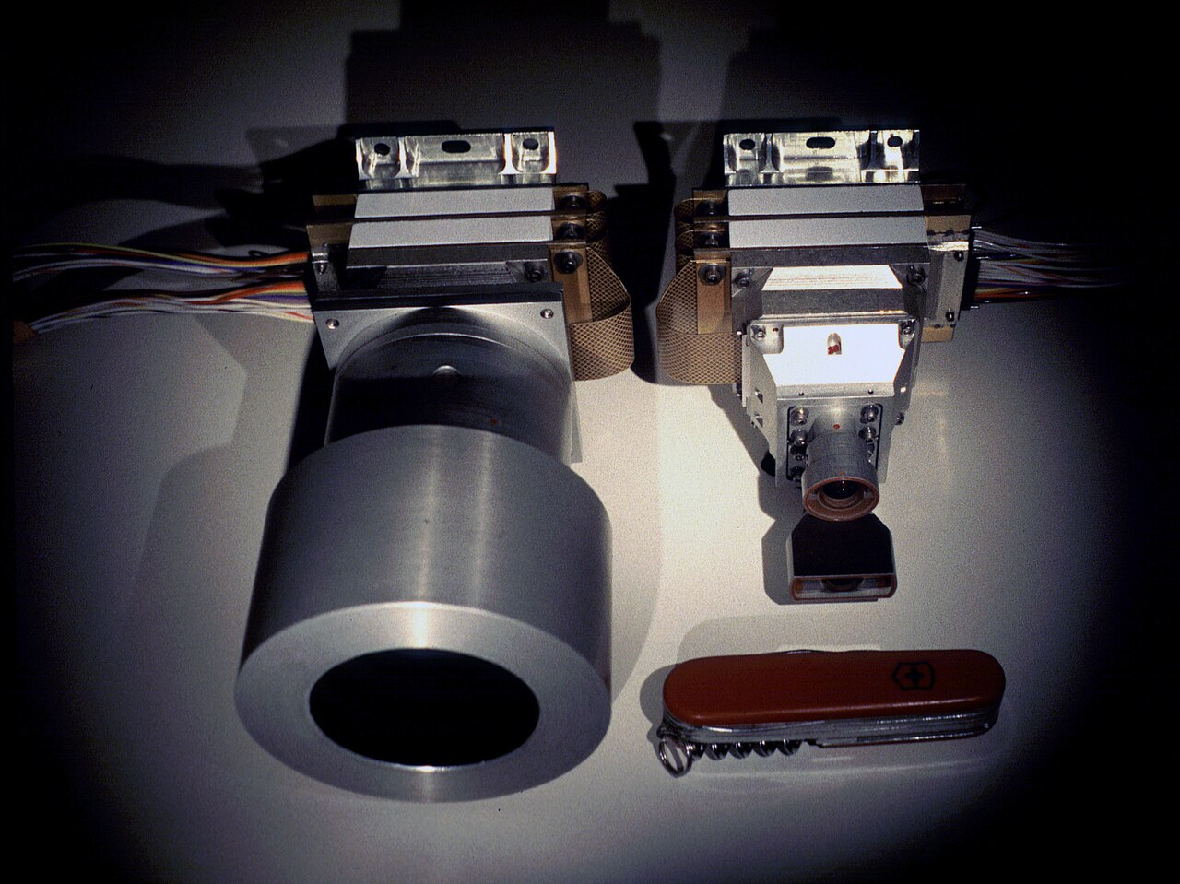
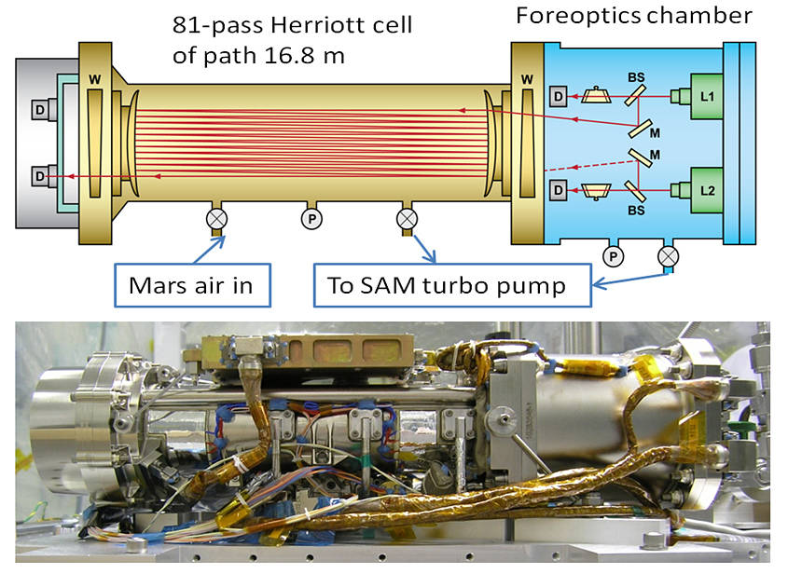
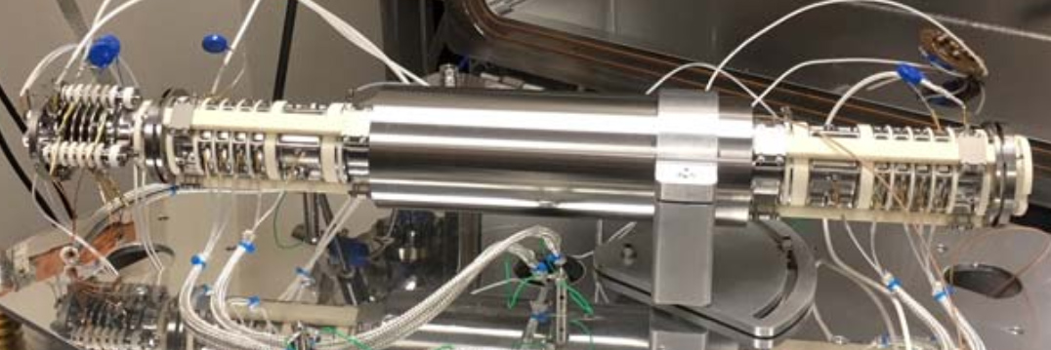
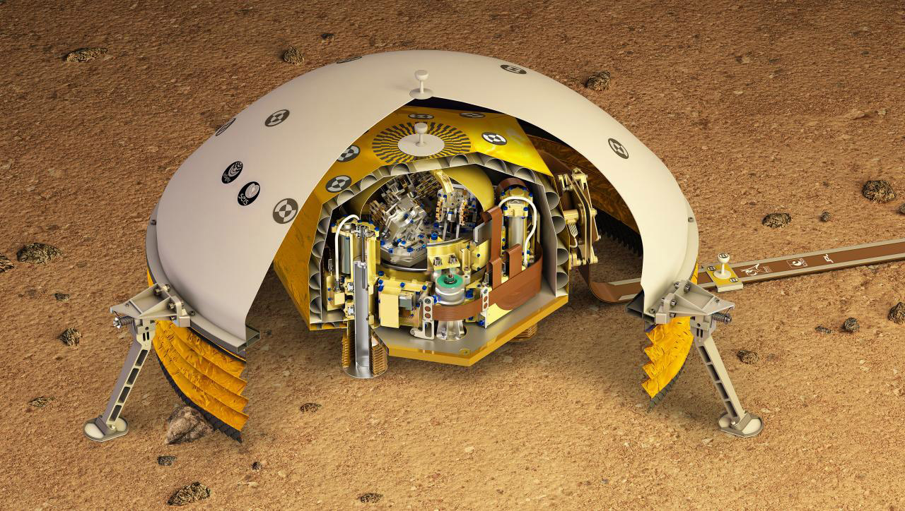
Instruments & Purpose
Mars Color Imager (MARCI)
Tunable Laser Spectrometer (TLS)
Purpose: Create a planet wide weather map
Utilizing: Visible & Ultraviolet optics
Goal: Understanding the resurfacing event that ended about 10 million years ago
Purpose: Measure trace gas species
Utilizing: Precisely tuned diode laser
Goal: Understand elements within the atmosphere
MAss Spectrometer for Planetary EXploration (MASPEX)
Seismic Experiment for Interior Structure (SEIS)
Purpose: Chemical composition of atmosphere
Utilizing: Temperature, pressure, and wind
Goal: Understanding the runaway greenhouse effects
Purpose: Planetary Geophysics Investigation
Utilizing: Seismic wave detection
Goal: Assessing tectonic activity and core dynamics
JD Morrissey
Notes:
Script
Realize Davinci’s instruments, want to use current try and tested instruments with a high TRL

Slide 8
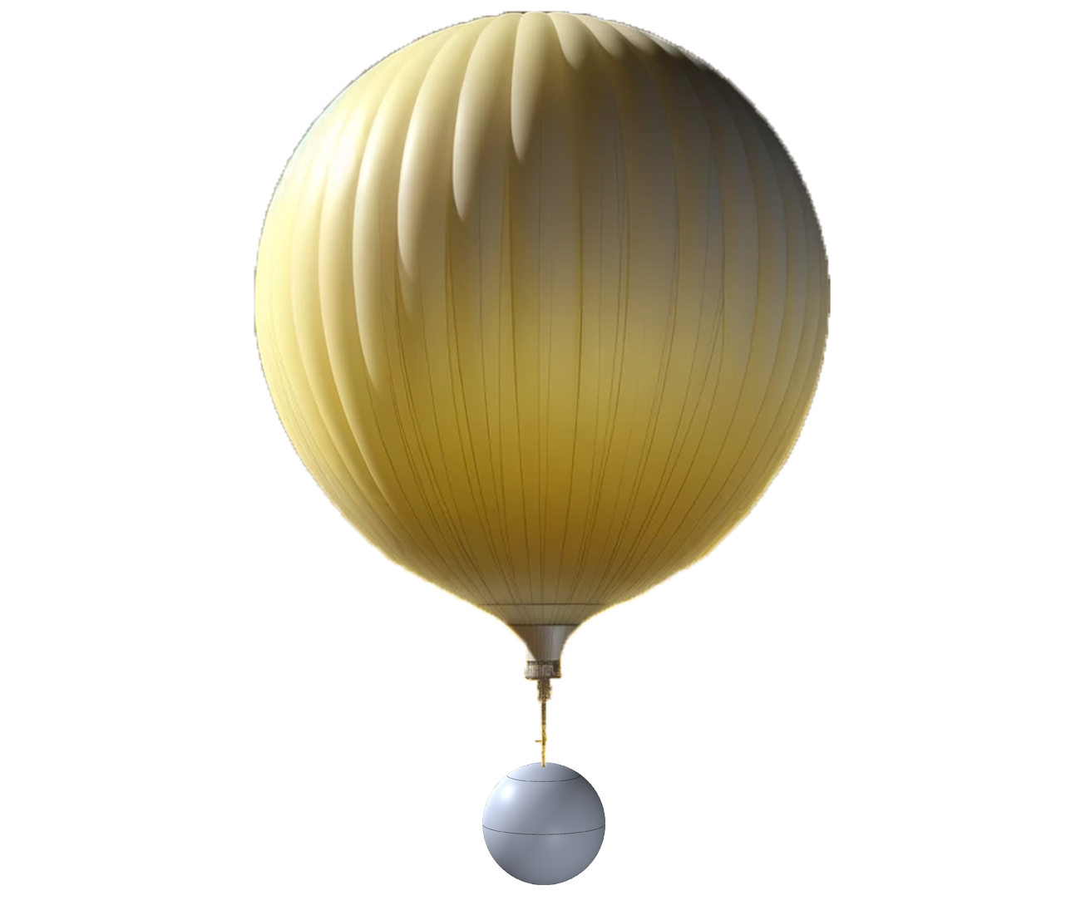
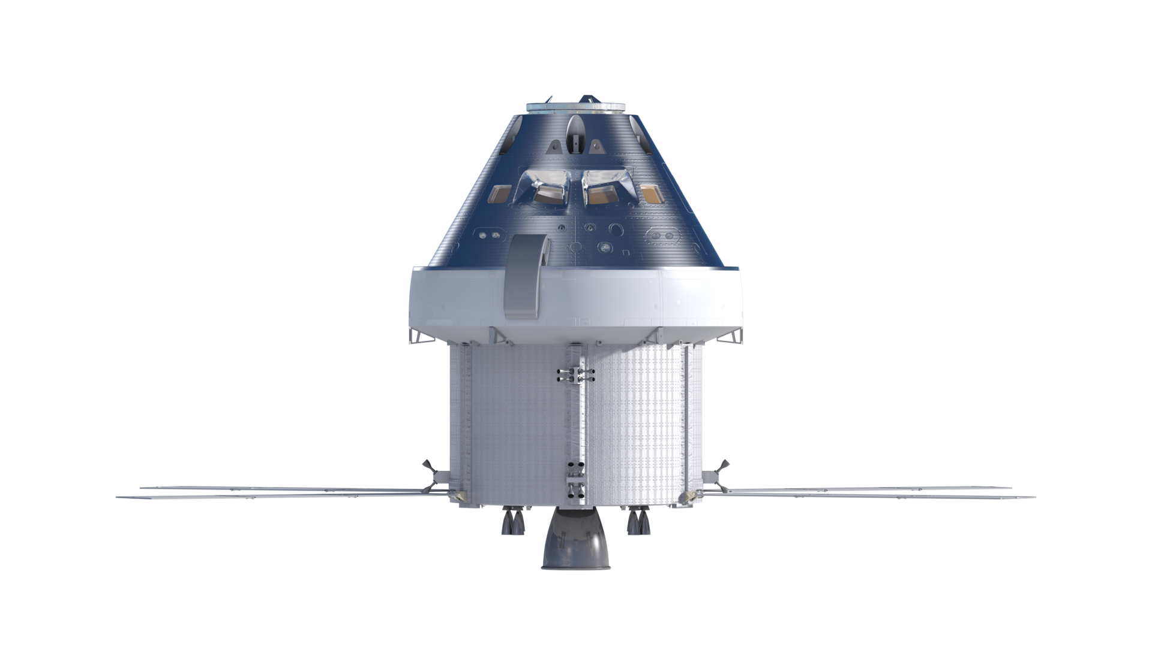
Benefits of a Crew Orbiting Venus
Human Interactions with the Payload
Direct spacecraft communications
Initiate entry, descent, & landing (EDL)
Adjust spacecraft altitude
Control instruments (on/off)
Analyze telemetry data in real time
Select high return science areas
Monitor health of spacecraft
JD Morrissey

Slide 9
Architecture & Schedule
JD Morrissey

Slide 10
Spacecraft Work Breakdown Structure
1.0 Payload
0.0 Spacecraft
2.0 Structure
4.0 Power
3.0 Thermal Control
1.1 MARCI
1.2 TLS
1.3 MASPEX
2.1 Gondola
2.2 Mechanisms
2.3 Internal frame
3.1 High-emissivity outer coating
4.1 Hydrogen fuel cell
5.0 Communications
5.2 Transceiver
5.1 Receiver
1.4 SEIS
5.3 Antenna
6.0 Computers
6.1 Avionics
6.2 Data storage
7.0 Balloon
7.1 Hydrogen tank
7.2 Valves and lines
7.3 Parachute
7.4 Gas pump
4.2 Power management system
3.2 Low-emissivity coating
JD Morrissey

Slide 11
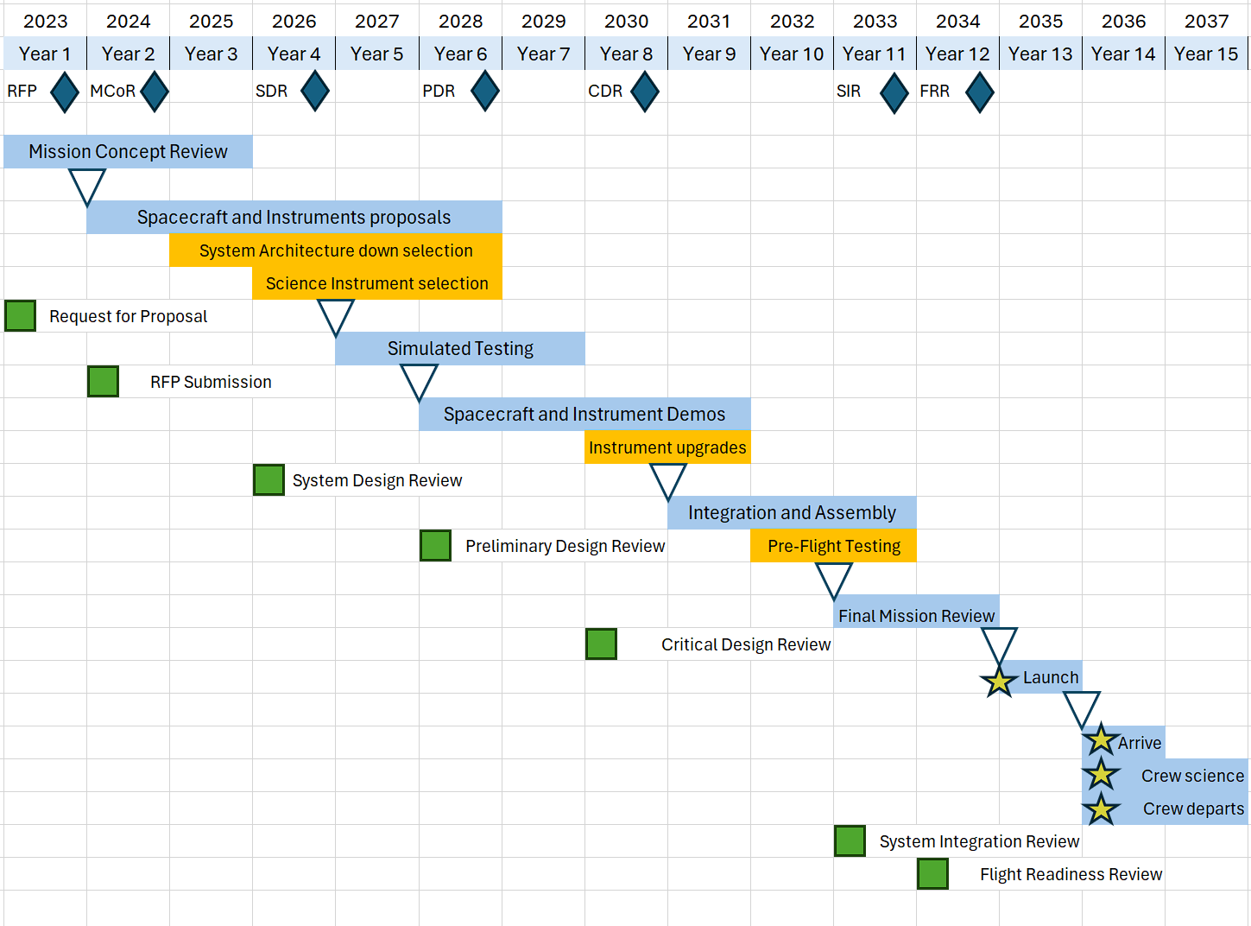
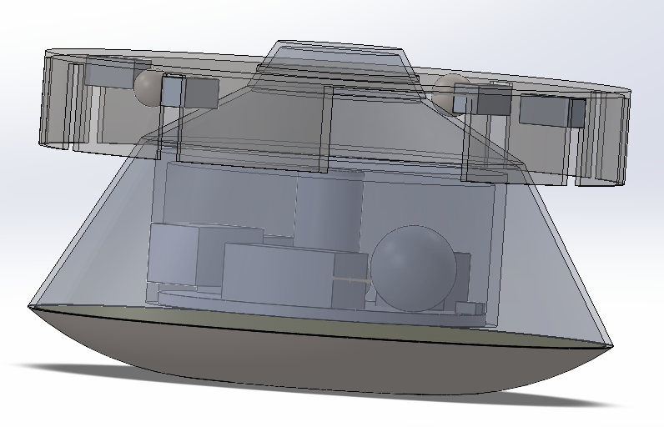
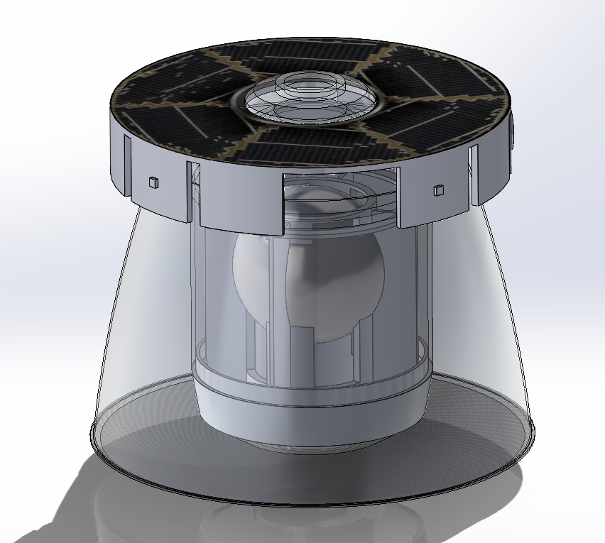
Mission Life Timeline
Arch #1
Arch #2
Arch #3
Alton Lo

Slide 12
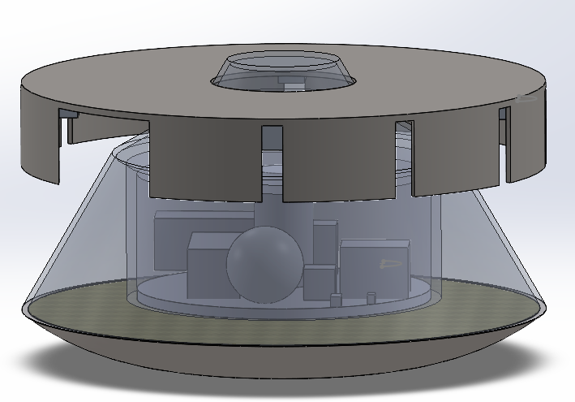
Architecture Trade Study
Architecture #1 Acquisition Cost: $1013 Million (USD) Approach to obtain science: 4x Probe Mass: 8628.81 kg Science achievable: Weather, gas detection, pressure, seismic waves Crew involvement: Initiate probe deployments, utilize scientific instruments to collect science data, monitor telemetry 6. Technology readiness level (TRL): 8
Architecture #2 Acquisition Cost: $950 Million (USD) Approach to obtain science: Balloon Mass: 6952 kg Science achievable: Weather, gas detection, pressure, seismic waves Crew Involvement: Constant communication with the payload, active system navigation, monitor telemetry, monitor wind patterns Technology readiness level (TRL): 6
Architecture #3 Acquisition Cost: $760 Million (USD) Approach to obtain science: Balloon Mass: 7045.45 kg Science achievable: Weather, gas detection, pressure, seismic waves Crew involvement: Constant communication with the payload, active system navigation, monitor telemetry, monitor wind patterns, initiate descent to surface Technology readiness level (TRL): 5
7 m
2.8 m
3.6 m
3.5 m
5 m
4.1 m
Alton Lo
Notes:
6884.06

Slide 13
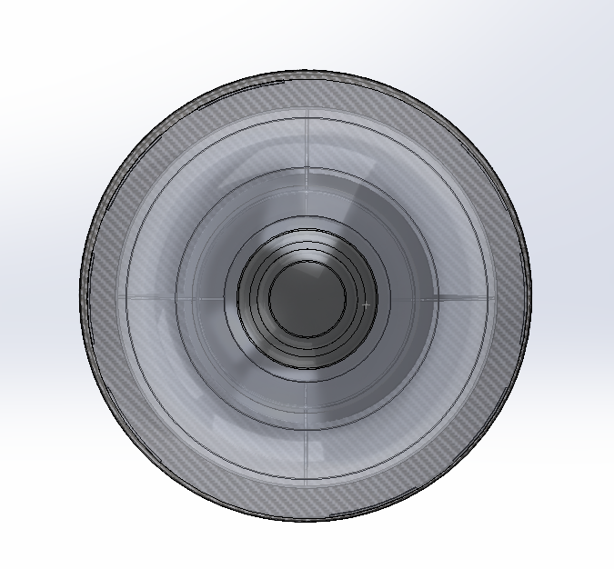
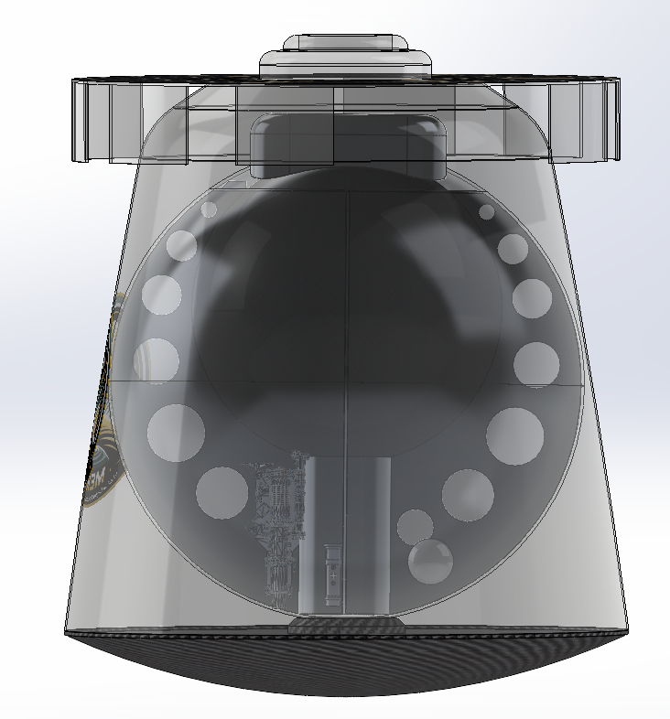
Architecture #3
3.04 m
3.6 m
Alton Lo
3.2 m
Alton Lo

Slide 14
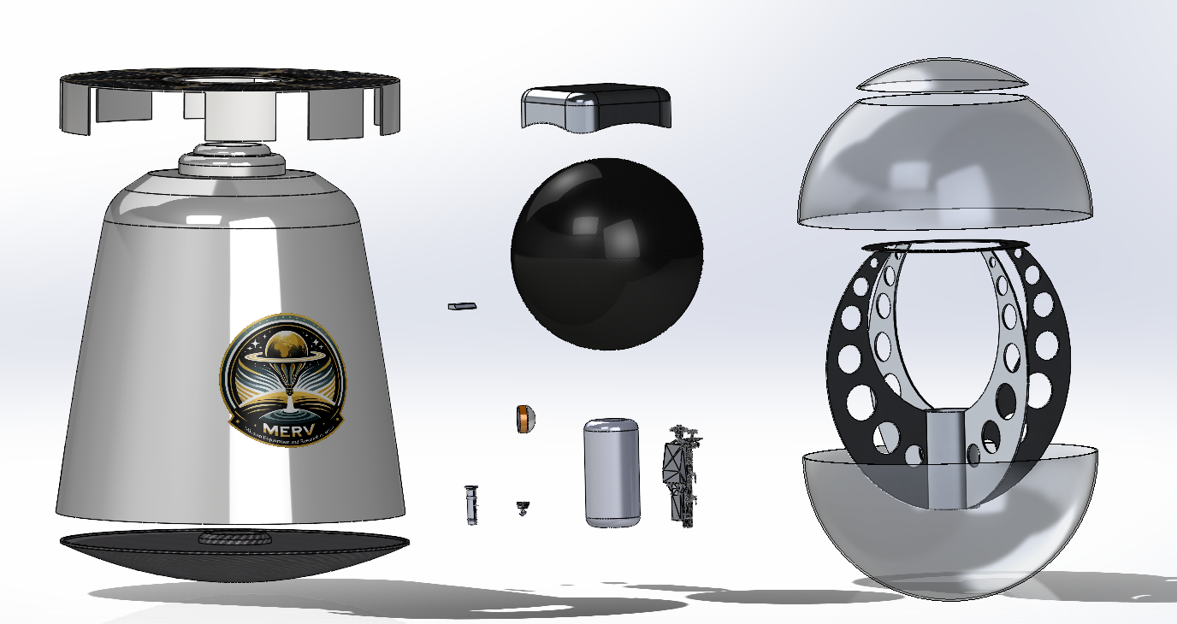
Design Exploded-View and Call-outs
Packed Balloon
Hydrogen Tank
Cruise Stage
Gondola Outer Structure
Balloon
Mechanism
Back shell
MASPEX
Gondola Inner Structure
SEIS
Heat Shield
TLS
MARCI
Fuel Cell
* Components not to scale
Alton Lo

Slide 15
CONOPS (Concept-of-Operations)
Alton Lo

Slide 16
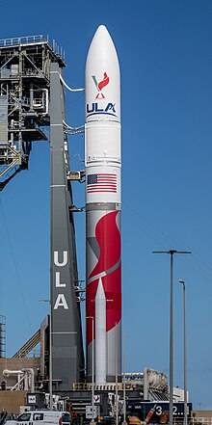
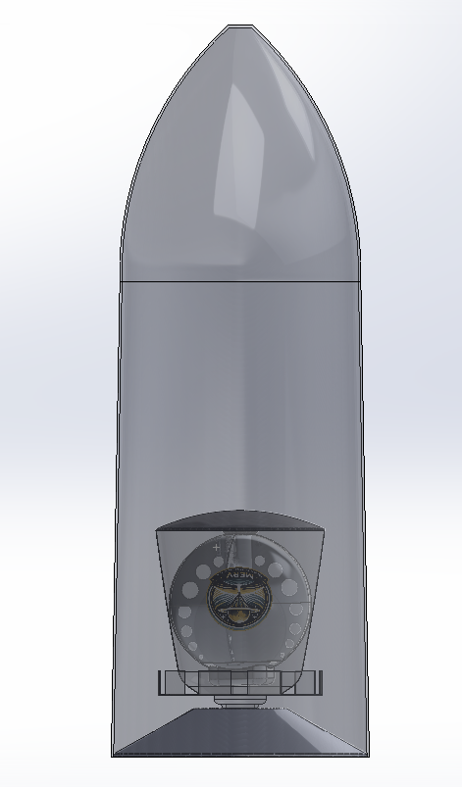
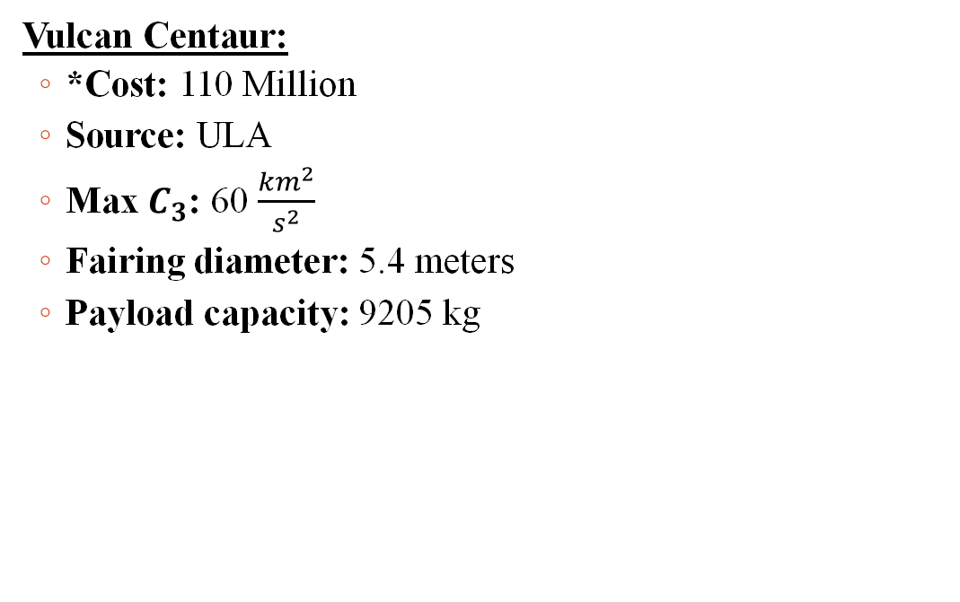
Launch Vehicle: Vulcan VC6
Vulcan Centaur:
*Cost: 110 Million
Source: ULA
Max $C_{3}$: 60 $\frac{{km}^{2}}{s^{2}}$
Fairing diameter: 5.4 meters
Payload capacity: 9205 kg
15.5 m
* Launch cost isn’t part of budget as mentioned by AIAA RFP
3.6 m
Alton Lo

Slide 17
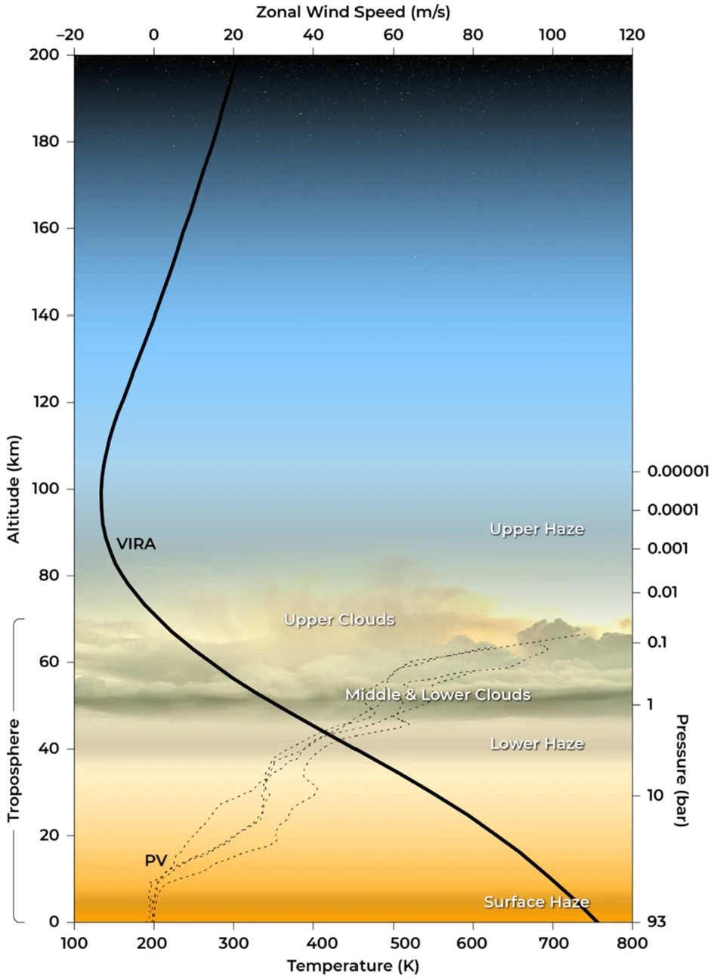
Planetary Protection and Atmosphere
Altitude range (45-55 km)
Density: 66.07 - 70 kg/m³
Temperature: 300-400 K
Pressure: ~1-2 atm
Zonal Wind Speed: 20-40 m/s
Category II missions (COSPAR – Committee on Space Research)
Celestial bodies of interest for studying chemical evolution and the origins of life
Actions
Clean-room assembly (IEST-STD-CC1246 D/E)
Sanitize spacecraft before launch
Measuring outgassing of materials
Green propellant
Sterilize inflation (inert) gas to prevent any microbiology
Killed by Venusian atmosphere, if otherwise
Goldilocks Zone
Courtesy: VIRA
Francisco Sanudo
Notes:
Mention how the calculation for the scale height of the Venusian atmosphere was used to find the altitude for ideal operations (back-up slides)
[script]
I'll be discussing the atmospheric conditions our aeroshell will encounter on Venus and the planetary protection measures we're implementing in line with COSPAR guidelines.
Let's begin with the atmospheric conditions. Our balloon will operate within the altitude range of 45 to 55 kilometers above the surface of Venus. At this altitude:
The density is approximately 66.07 to 70 kilograms per cubic meter.
We anticipate temperatures ranging from 300 to 400 Kelvin.
The pressure is roughly 1 to 2 atmospheres.
And, the zonal wind speed is expected to be between 20 to 40 meters per second.
This region is crucial for our mission because it's within what we call the 'Goldilocks Zone.' It's not too harsh for our instruments, allowing us to collect valuable data on Venusian climate and atmospheric chemistry.
Moving on to COSPAR classifications, our mission falls under Category II. This means we're visiting a celestial body with significant interest in studying chemical evolution and the potential origins of life.
To ensure compliance with COSPAR's planetary protection standards, we are taking several actions:
Our aeroshell assembly will occur in a controlled clean-room environment, following the IEST-STD-CC1246D standard.
We'll sanitize the spacecraft thoroughly before launch to prevent any terrestrial microbes from hitching a ride.
We're also focused on measuring outgassing of materials, a key consideration for maintaining a pristine environment.
The use of green propellant is part of our commitment to sustainability and reducing contamination.
And lastly, we'll be sterilizing our balloon's inflation gas. Although the harsh Venusian atmosphere would likely kill any microbial stowaways, we're not taking any chances.
Our adherence to these measures is critical to avoid biological contamination, protect Venus's environment, and uphold the integrity of our scientific investigations.

Slide 18
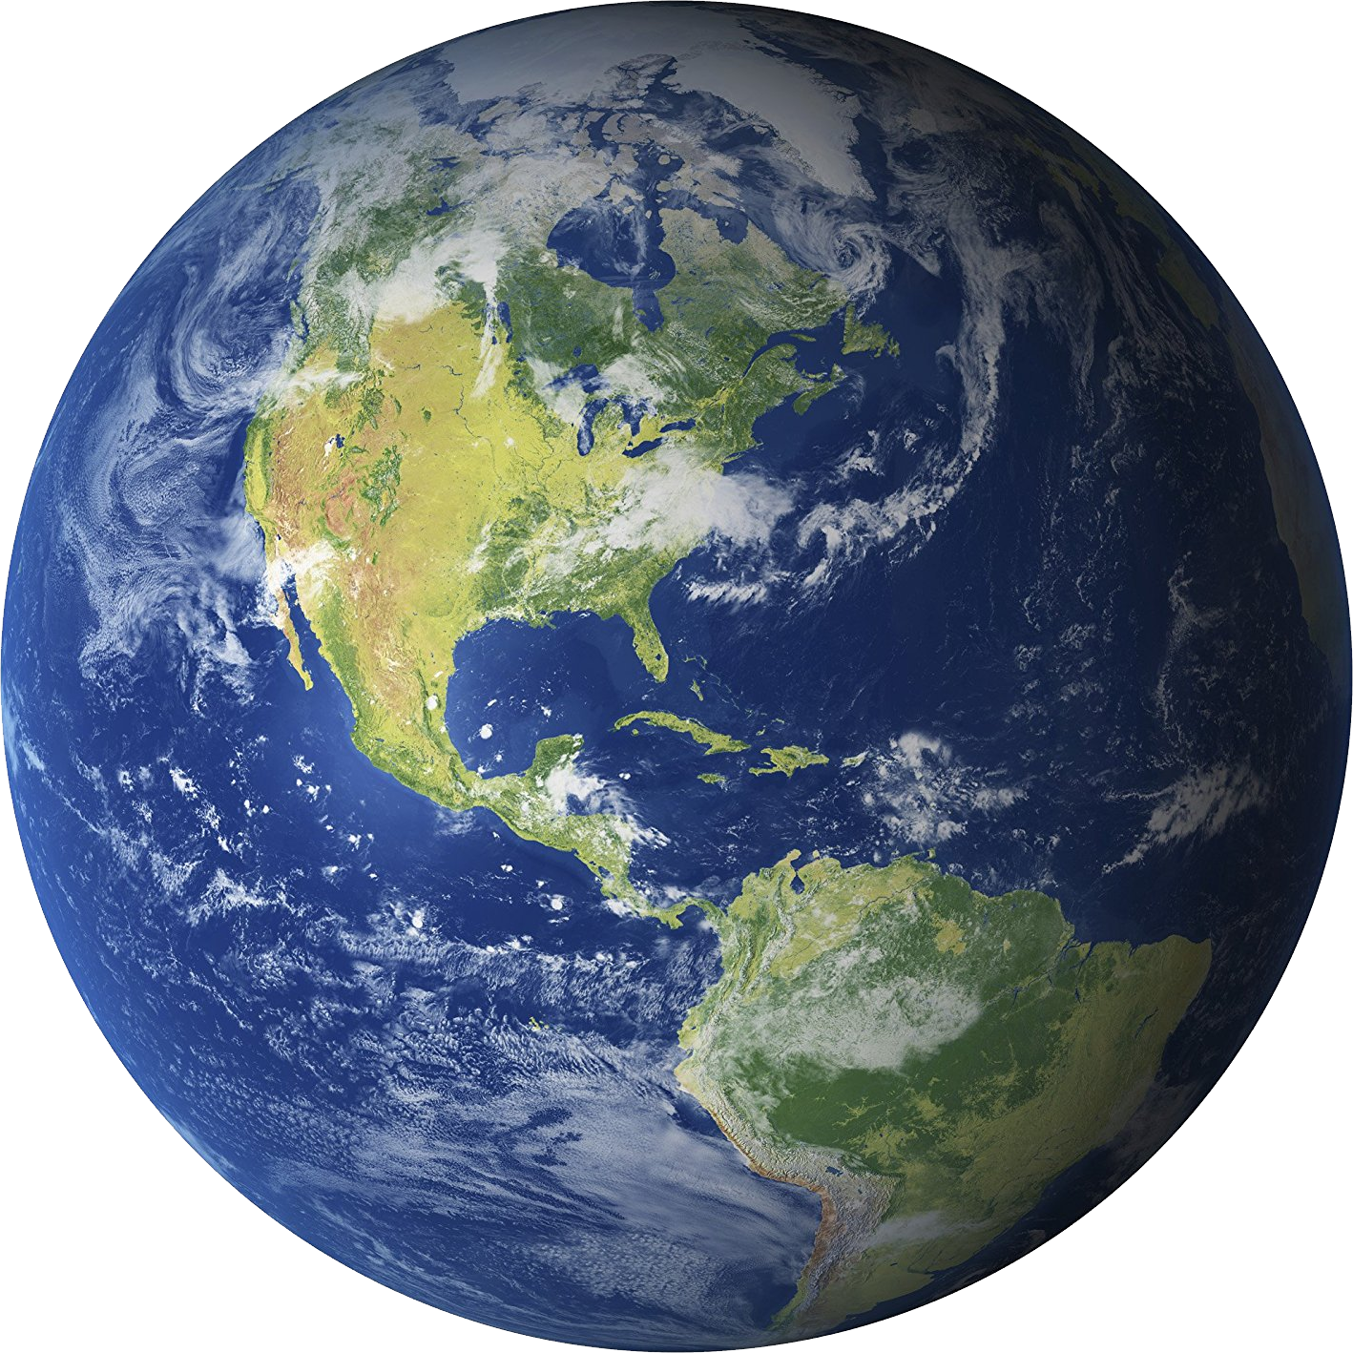
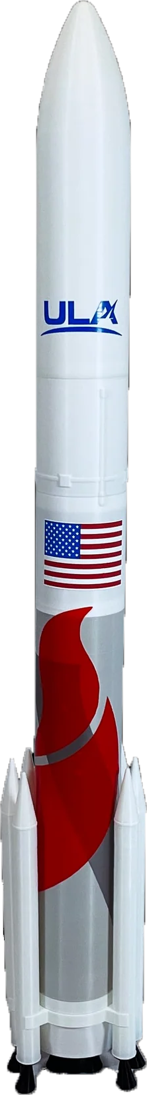
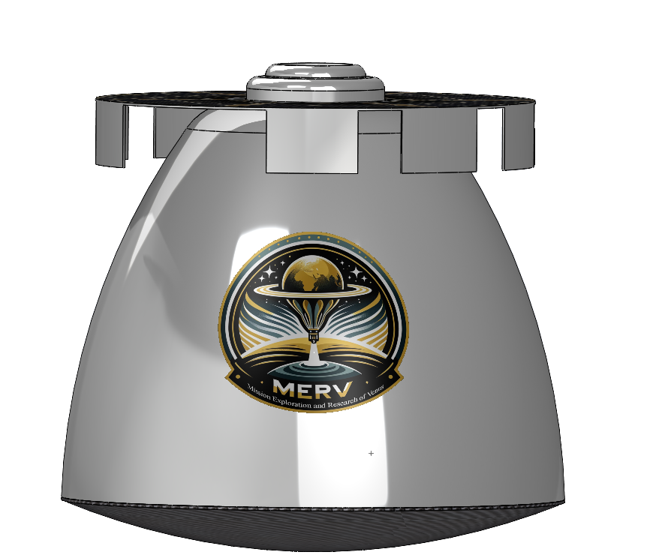
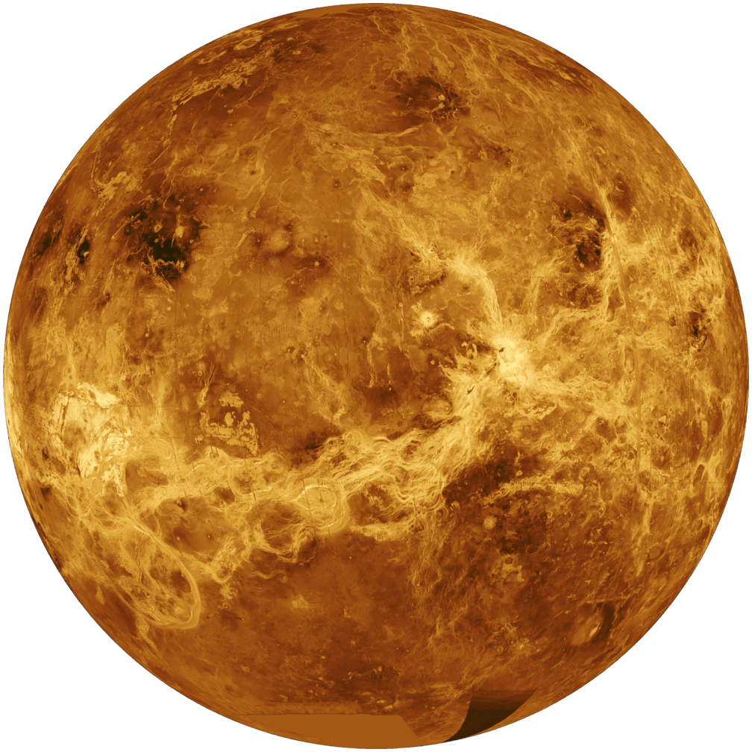
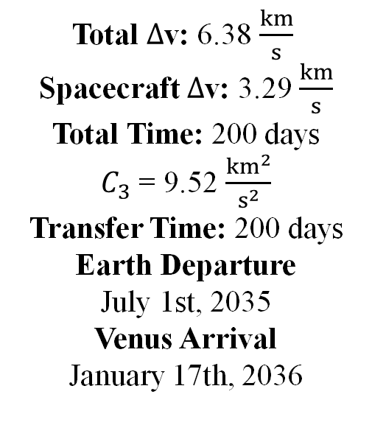
ConOps Diagram (Spacecraft)
Total $∆$v: 6.38 $\frac{km}{s}$
Spacecraft $∆$v: 3.29 $\frac{km}{s}$
Total Time: 200 days
$C_{3}$ = 9.52 $\frac{{km}^{2}}{s^{2}}$
Transfer Time: 200 days
Earth Departure
July 1st, 2035
Venus Arrival
January 17th, 2036
(1) Upper stage and orbiter
(2) Trans-Venus injection burn
(3) Spacecraft detaches from upper stage
(4) *Mid-course correction
(5) *Venus Orbit insertion to parking orbit
(6) *Spacecraft enters Venusian atmosphere
*Affects design of attitude control system
Francisco Sanudo
Notes:
[script]
Let's now turn our attention to the journey of our spacecraft from Earth to Venus.
This slide presents our Mission Concept of Operations, the ConOps Diagram, illustrating the key maneuvers from Earth departure to Venus arrival.
[Point 1] The mission begins with our spacecraft, which includes the upper stage and the orbiter, launching from Earth's surface.
[Point 2] Once in orbit, we execute a Trans-Venus injection burn, propelling the spacecraft out of Earth's gravitational influence and setting it on a course for Venus.
[Point 3] After the injection burn, the spacecraft detaches from the upper stage. This separation is a critical point that influences the design of our attitude control system, ensuring stability for the rest of the voyage.
[Point 4] As we travel through interplanetary space, a mid-course correction will be made. This maneuver is essential to refine our trajectory, guaranteeing an accurate approach to Venus, considering any minor deviations that may have occurred post-launch.
[Point 5] Upon reaching Venus, the spacecraft will perform an orbit insertion burn to enter a parking orbit around the planet. The precision of this burn is crucial for establishing the desired orbital parameters and for the proper deployment of the aeroshell.
[Point 6] Finally, the spacecraft is prepared to enter the Venusian atmosphere, marking the beginning of the aeroshell's operations and the balloon deployment.

Slide 19
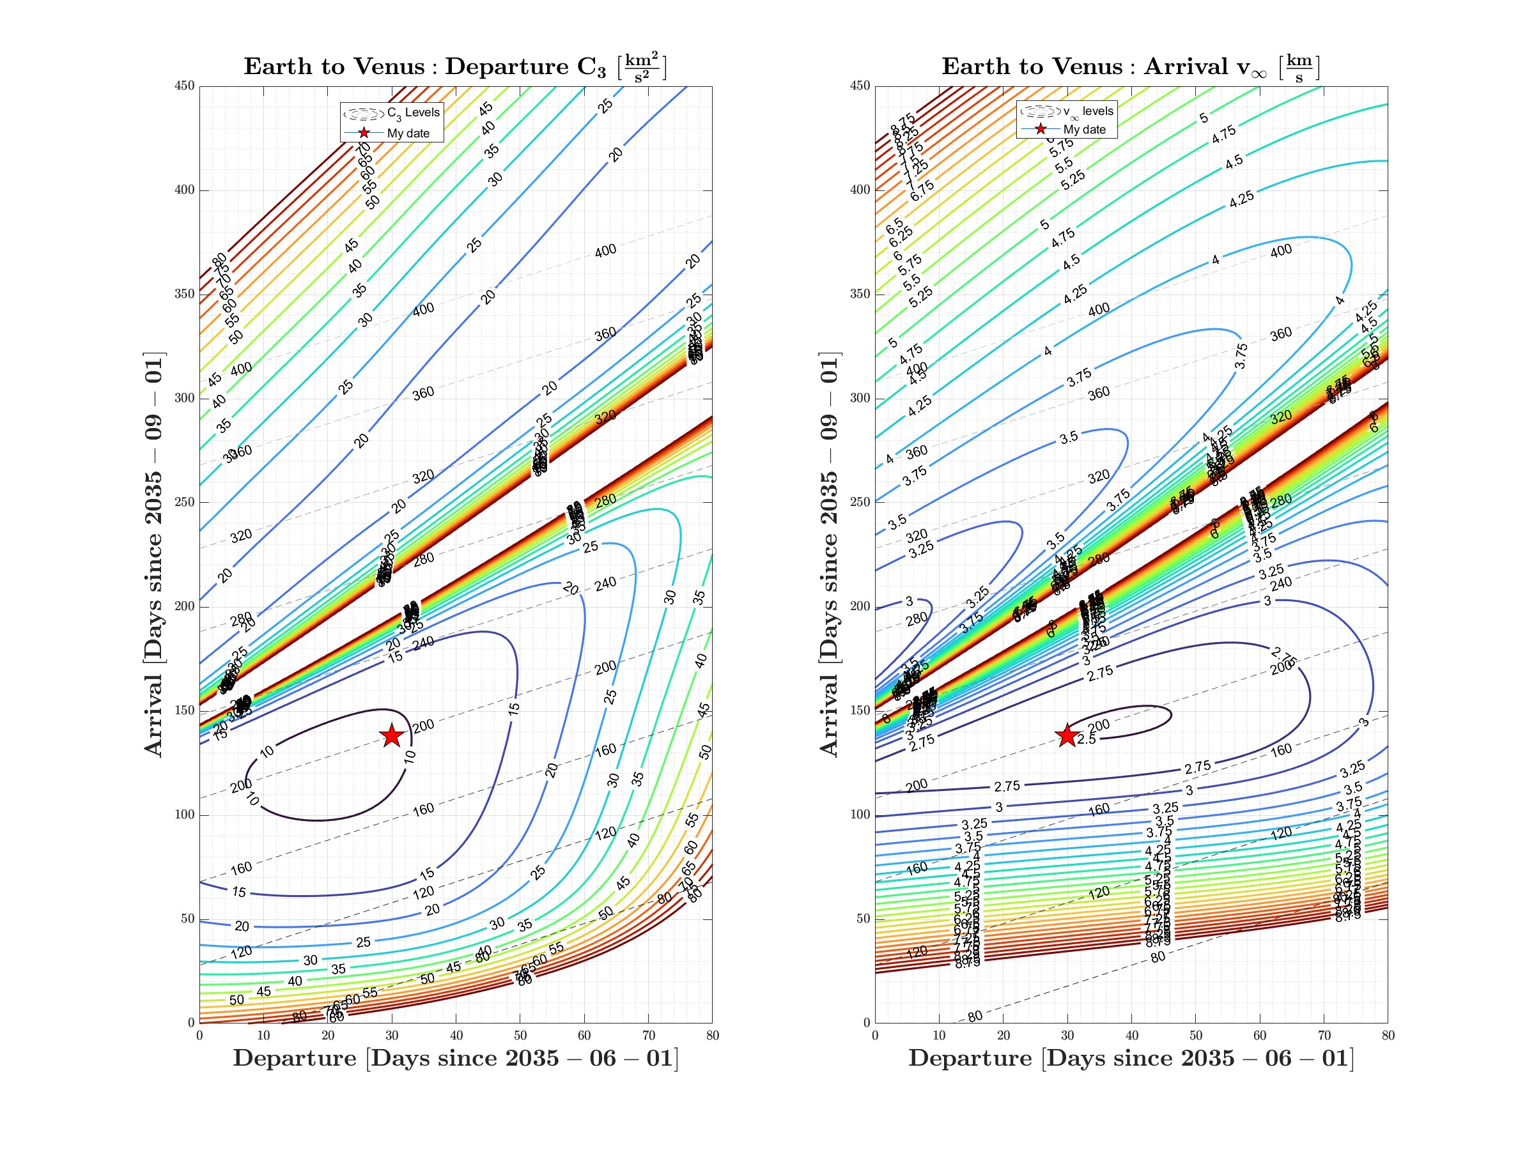
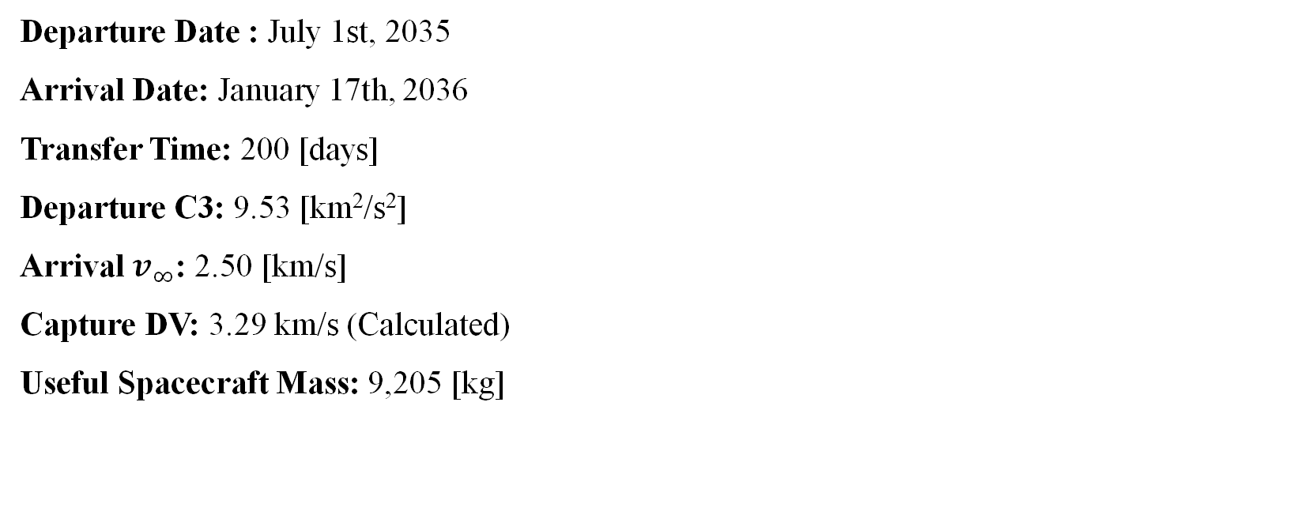
Porkchop Plots (Spacecraft)
Departure Date : July 1st, 2035
Arrival Date: January 17th, 2036
Transfer Time: 200 [days]
Departure C3: 9.53 [km²/s²]
Arrival $v_{∞}$: 2.50 [km/s]
Capture DV: 3.29 km/s (Calculated)
Useful Spacecraft Mass: 9,205 [kg]
Optimal departure and arrival dates
Francisco Sanudo
Notes:
[script]
With a clear understanding of our spacecraft's journey from Earth to Venus, let's delve deeper into the trajectory planning. On the right, you'll see two porkchop plots which allowed us to visualize the relationship between launch & arrival dates, along with the energy required for the spacecraft to transfer between the two bodies.
We evaluated numerous potential launch dates, but one combination stood out.
Departing Earth on July 1st, 2035, and arriving at Venus on January 17th, 2036, provided the best balance of low-energy requirements and favorable conditions for our scientific mission at Venus.
The useful mass of the spacecraft, after accounting for all fuel and consumables needed for this journey, stands at 37,900 kilograms. This mass budget is crucial, as it directly impacts our capacity to carry scientific instruments and other mission-critical systems.

Slide 20
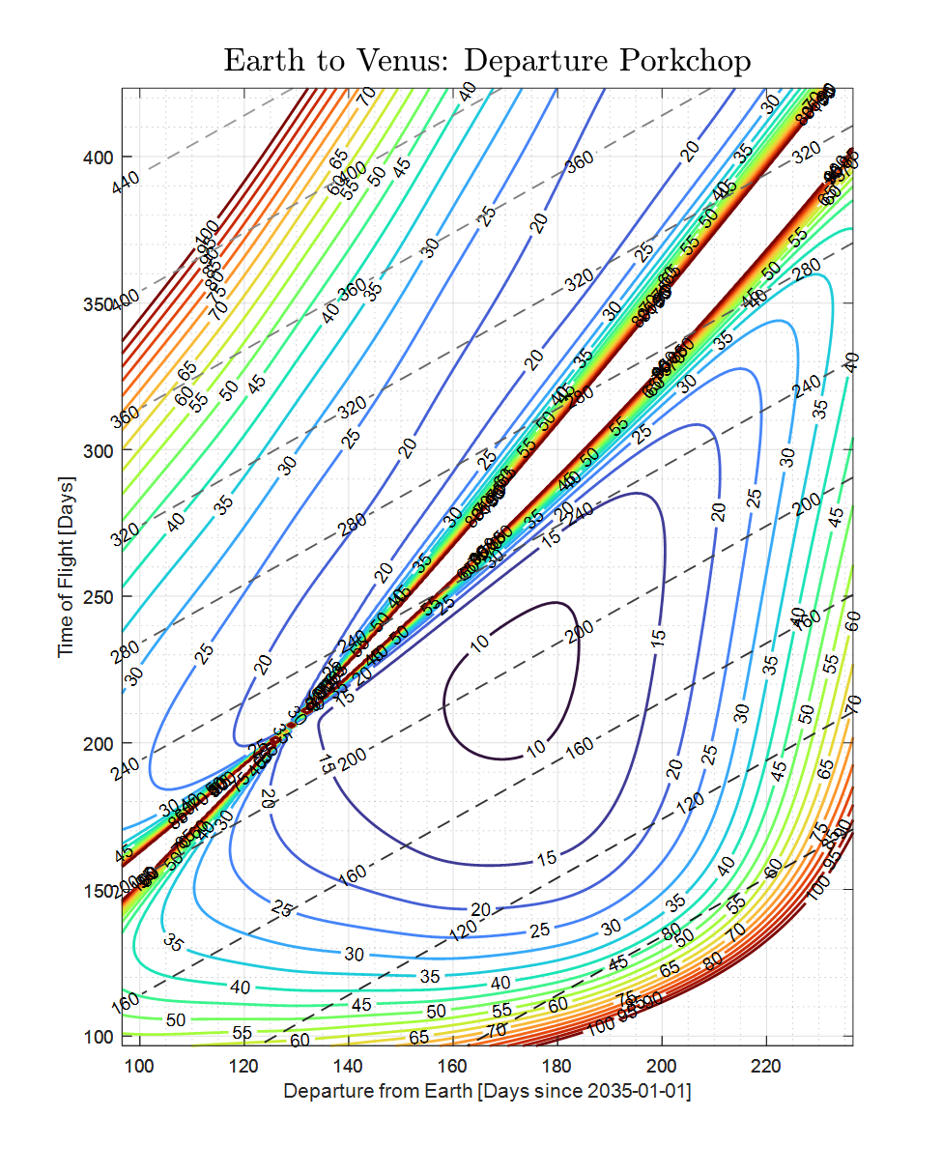
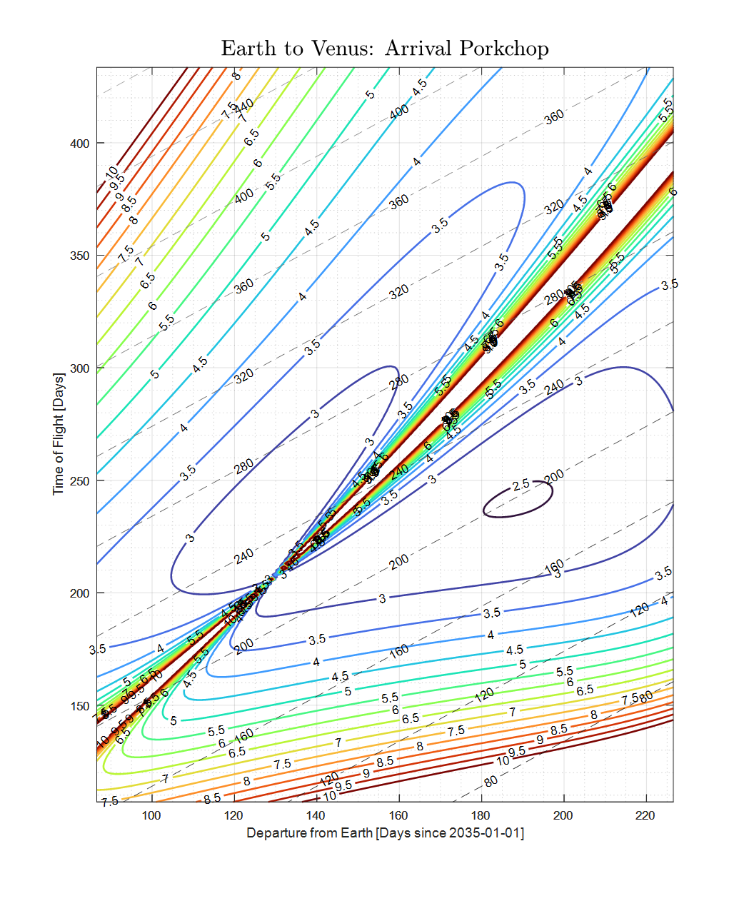
Porkchop Plots (Crew Module)
Departure Date: August 9th, 2035
Arrival Date: January 16th, 2036
Transfer Time: 160 [days]
Departure C3: 33 [km²/s²]
Optimal departure and arrival dates
Francisco Sanudo
Notes:
[script]
We now shift our focus to the trajectory planning for the crew module that will oversee operations. While the crew component is outside the scope of our Request for Proposal (RFP), their trajectory is vital for ensuring mission consistency and potential future expansions of the mission scope.
The optimal departure date for the crew module is set for August 9th, 2035, with an arrival date on Venus of January 16th, 2036. The transfer will take 160 days, which is a period of time optimized for crew well-being and system reliability.
By ensuring that the crew module's trajectory is compatible with that of our unmanned spacecraft, we've laid the groundwork for a cohesive mission strategy, with human oversight enhancing the safety and success of our scientific endeavors on Venus.

Slide 21
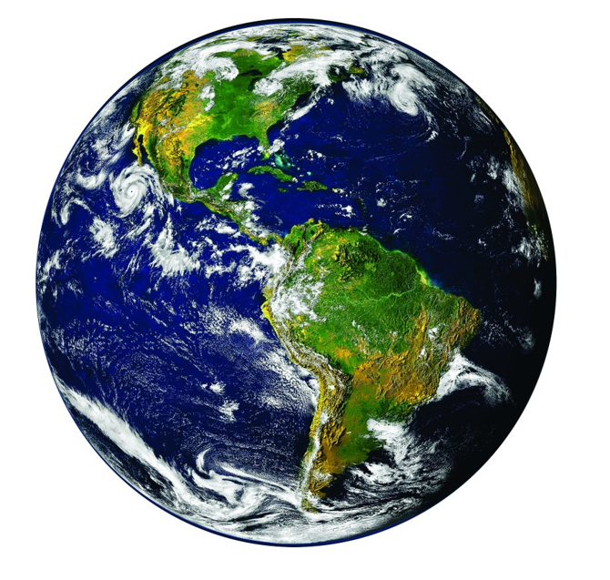
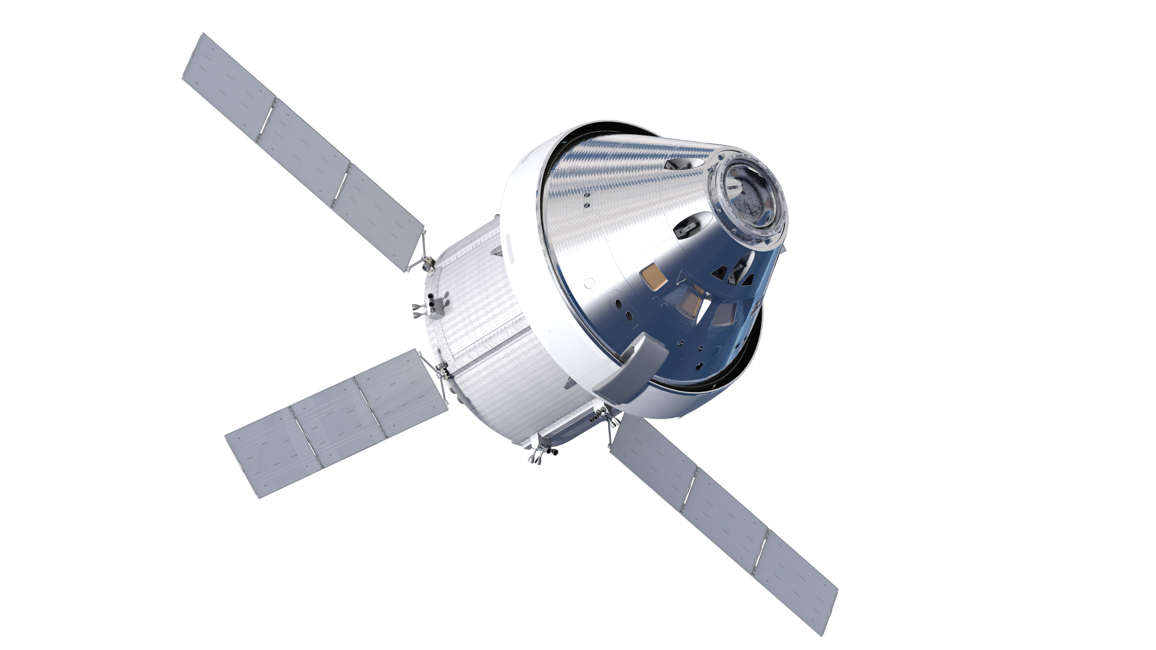
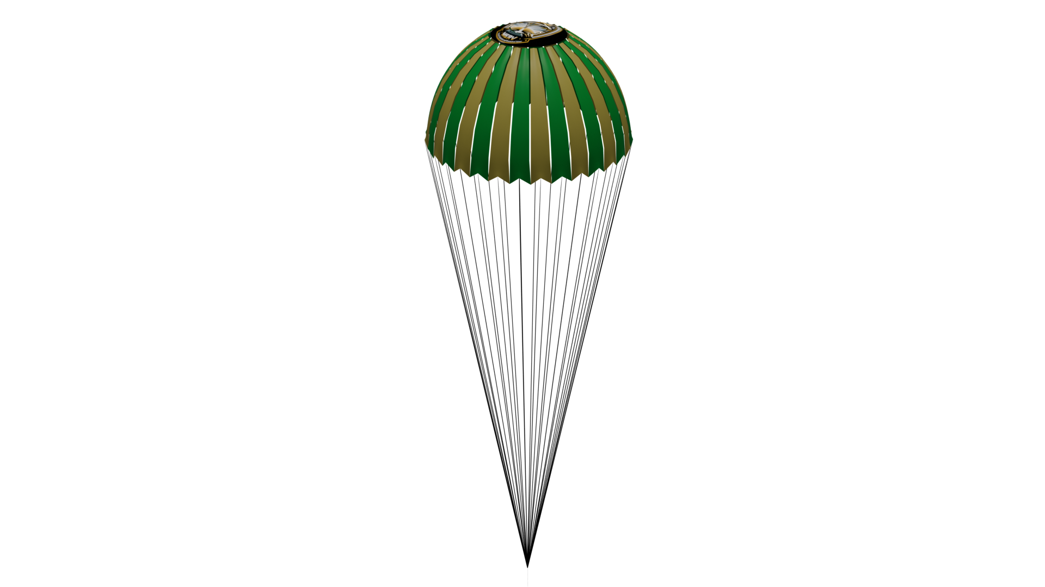
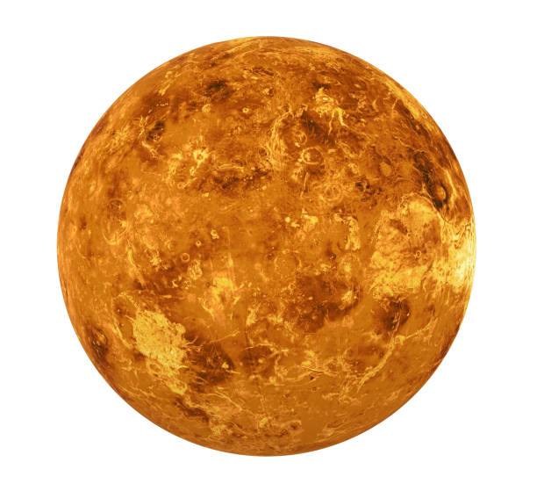
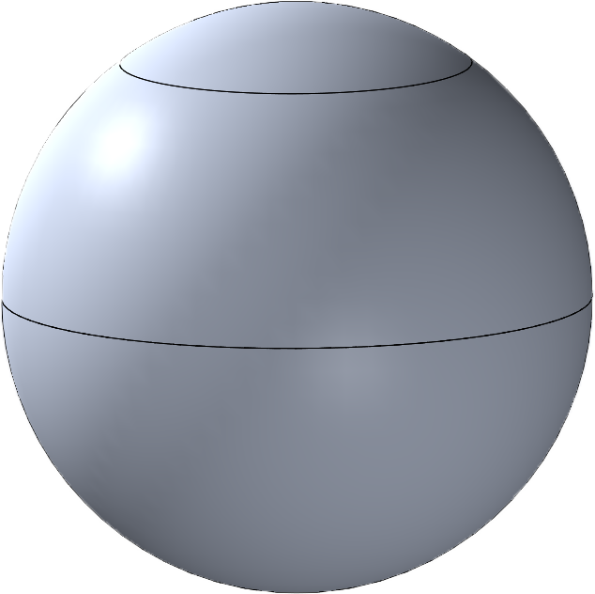
EDL Comms Diagram
Crew-module
X-Band
X-Band
S-Band
Aeroshell will establish comms with crew prior & during entry descent and landing (EDL)
Crew will monitor the aeroshell’s status during entire EDL sequence
Crew will make real-time adjustments of the EDL trajectory, if necessary
Aeroshell + Payload
(pre-separation)
Payload
(post-separation)
Francisco Sanudo
Notes:
[script] Let's examine the communication strategy during Entry, Descent, and Landing—or EDL—operations
This diagram outlines the EDL communications architecture. Communication is key to monitoring and controlling the aeroshell through the EDL process.
[Describe Communication Links]
On the left, we see our aeroshell with the payload, still attached prior to separation. The aeroshell is equipped to maintain a communication link with the crew module via S-Band during the initial EDL phases.
As we move to the right, post-separation, the payload alone will continue to communicate with the crew module, now using X-Band to relay status updates and receive any necessary commands.
[Point to Earth]
The crew module itself maintains a continuous X-Band link back to Earth. This redundancy ensures that we have real-time oversight from mission control and can react quickly to any anomalies.
[Bullet Points]
The aeroshell will establish communications with the crew prior to and during the EDL. This ensures that the crew is aware of the mission status in real-time.
Our crew will actively monitor the aeroshell’s status throughout the entire EDL sequence. This monitoring is crucial, especially during this high-risk phase of the mission.
If needed, the crew has the capability to make real-time adjustments to the EDL trajectory. This level of control is crucial for mission adaptability and responsiveness to the dynamic conditions of Venus's atmosphere.

Slide 22

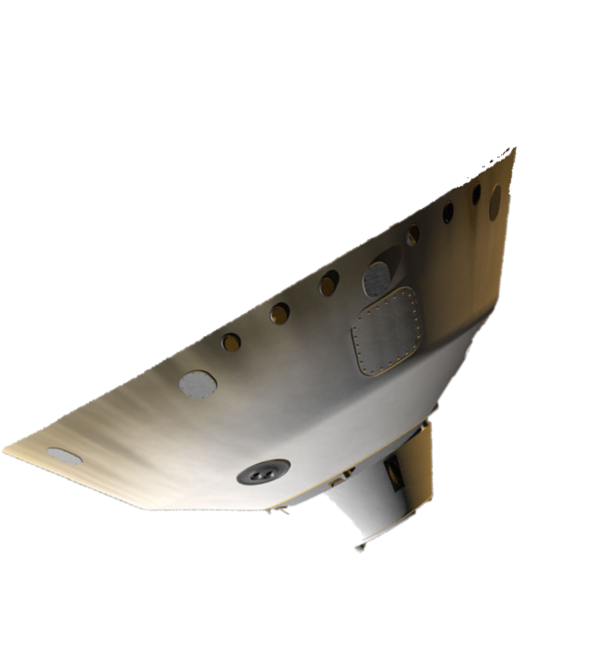
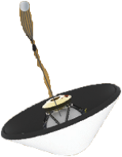
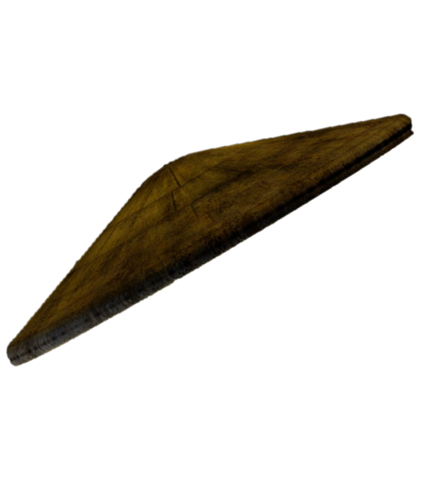
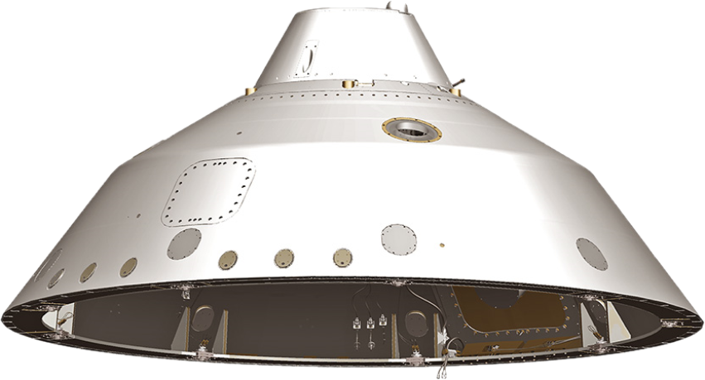
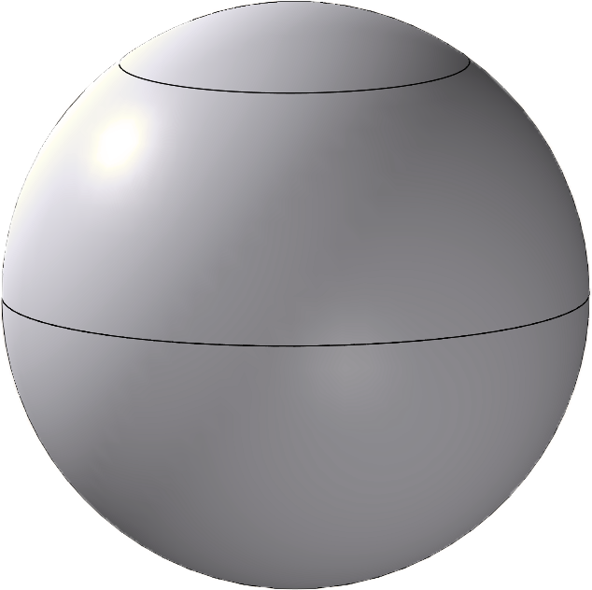
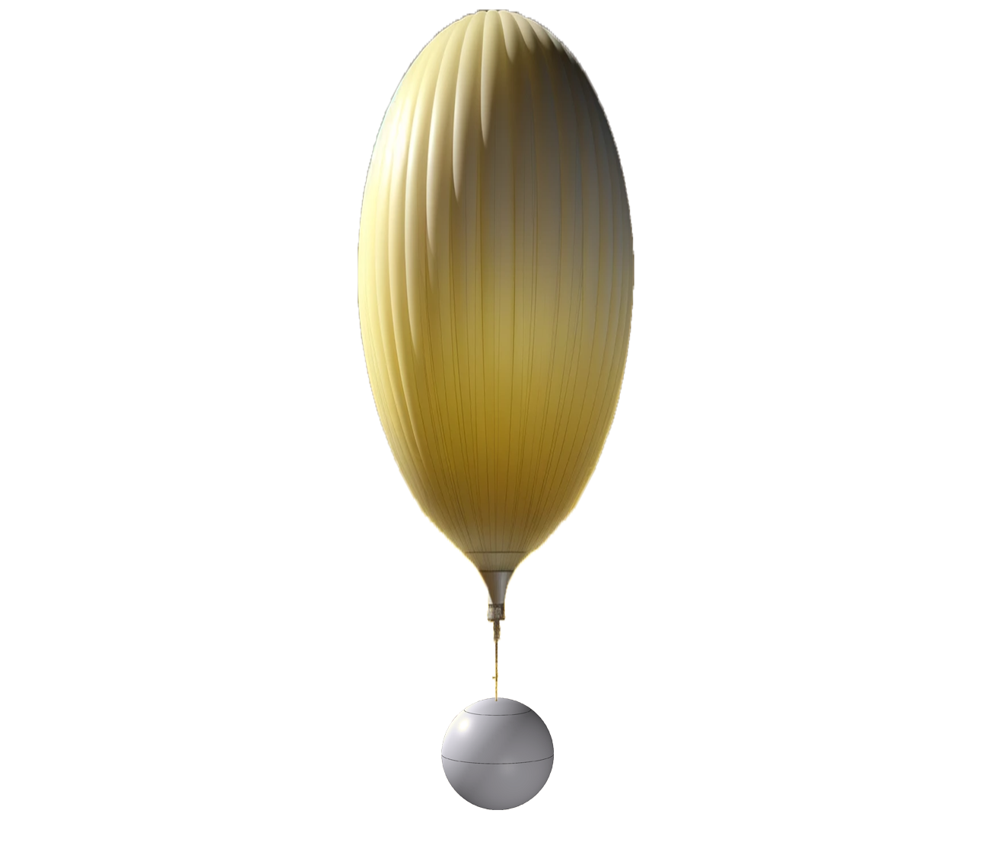

*Chute fully expanded
Back shell Separation
Time: ~40 min
Alt.: 75 km
Pressure: 1 x 10⁻⁵ atm
Temp.: 200 K
Vel.: 0.672 km/s
Eject main chutes
Begin balloon inflation
Time: ~83 min
Altitude: 50 km
Pressure: 0.5 atm
Temperature: 230 K
Velocity: 0.176 km/s
Balloon inflation complete
Time: ~85 min.
Alt.: 45 km
Pressure: 0.8 atm
Temp.: 350 K
Vel.: 0.115 km/s
100
85
*Heat Shield Separation
Time: ~10 min
Alt.: 97 km
Pressure: 1 x 10⁻⁵ atm
Temp.: 175 K
Vel.: 5.264 km/s
*Deploys main chutes
Time: ~25 min
Alt.: 85 km​
Pressure: ​1 x 10⁻³ atm​
Temp.: 185 K​
Vel.: 2.183 km/s
Altitude (km)
70
55
Time (Earth Minutes)
45
0
40
83
10
25
85
Rene Holmes
Notes:
[script]
Here we see the key phases of the descent into the Venusian atmosphere, each with a distinct objective and challenge.
[Phase 1: Heat Shield Separation]
Approximately 10 minutes after atmospheric entry, at an altitude of 97 kilometers, we'll initiate the heat shield separation. The environment at this altitude has a pressure of only 1x10^-5 atm and a temperature of 175 Kelvin. The aeroshell will be traveling at a velocity of 5.264 kilometers per second, and the heat shield’s job to protect our instruments from the intense entry heat will be completed.
[Phase 2: Chute Deployment]
At around 25 minutes into the descent, we'll be at an altitude of 85 kilometers, where we deploy the main parachutes. The pressure here is 1x10^-3 atm with a temperature of 185 Kelvin. Our descent velocity will slow significantly to 2.183 kilometers per second, thanks to the chutes' deployment.
[Phase 3: Backshell Separation]
Continuing downward to 75 kilometers, we reach a critical juncture about 40 minutes in, where we separate from the backshell. The pressure remains low at 1x10^-5 atm, and the temperature increases slightly to 200 Kelvin. The velocity is further reduced to 0.672 kilometers per second.
[Phase 4: Main Chutes Ejection and Balloon Inflation]
The ejection of the main chutes and the start of balloon inflation occur around the 83-minute mark, at an altitude of 50 kilometers. The conditions here start to become more moderate with a pressure of 0.5 atm and a temperature of 230 Kelvin, allowing for the safe inflation of the balloon. The descent slows to a velocity of 0.176 kilometers per second.
[Final Phase: Balloon Inflation Complete]
By approximately 85 minutes, balloon inflation is complete at an altitude of 45 kilometers, just at the edge of the Goldilocks Zone we discussed earlier. The pressure here is almost Earth-like at 0.8 atm, the temperature is a balmy 350 Kelvin, and our velocity is 0.115 kilometers per second.
This methodical, step-by-step approach ensures that by the time we fully inflate the balloon, our instruments are ready to begin their scientific exploration in a stable and controlled manner.

Slide 23
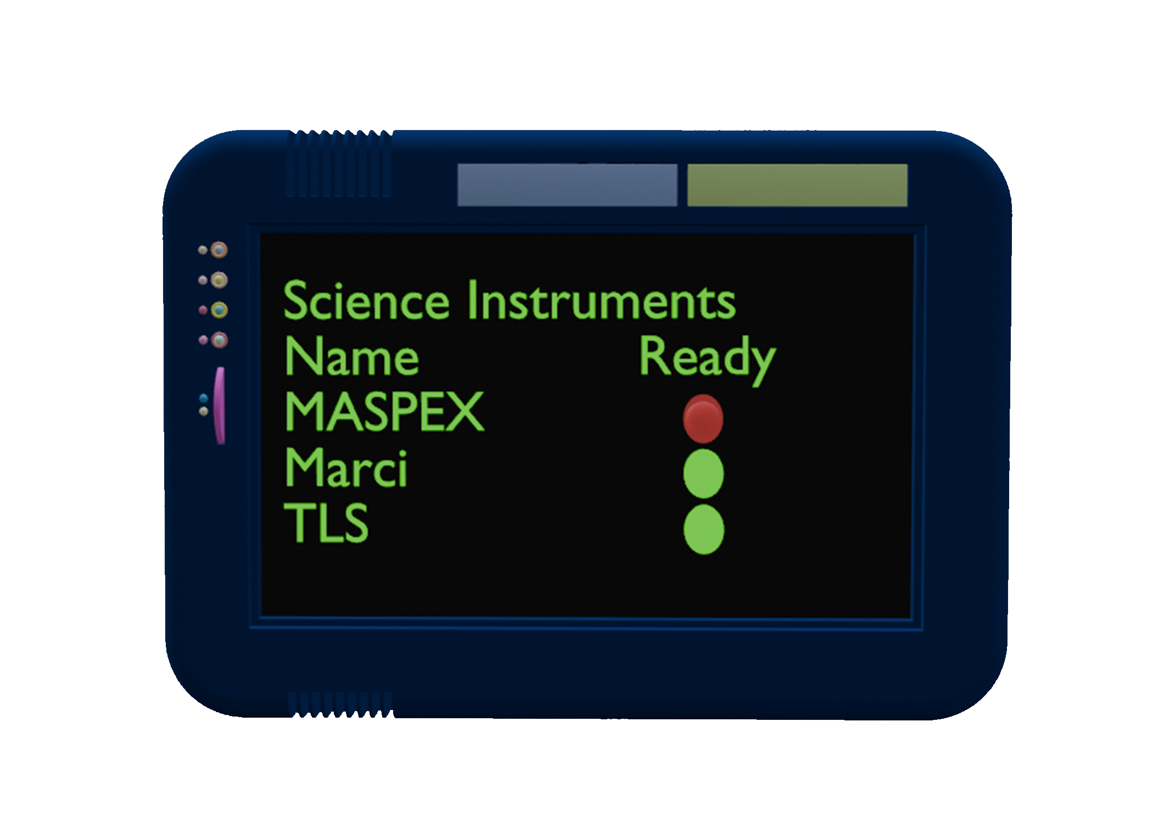
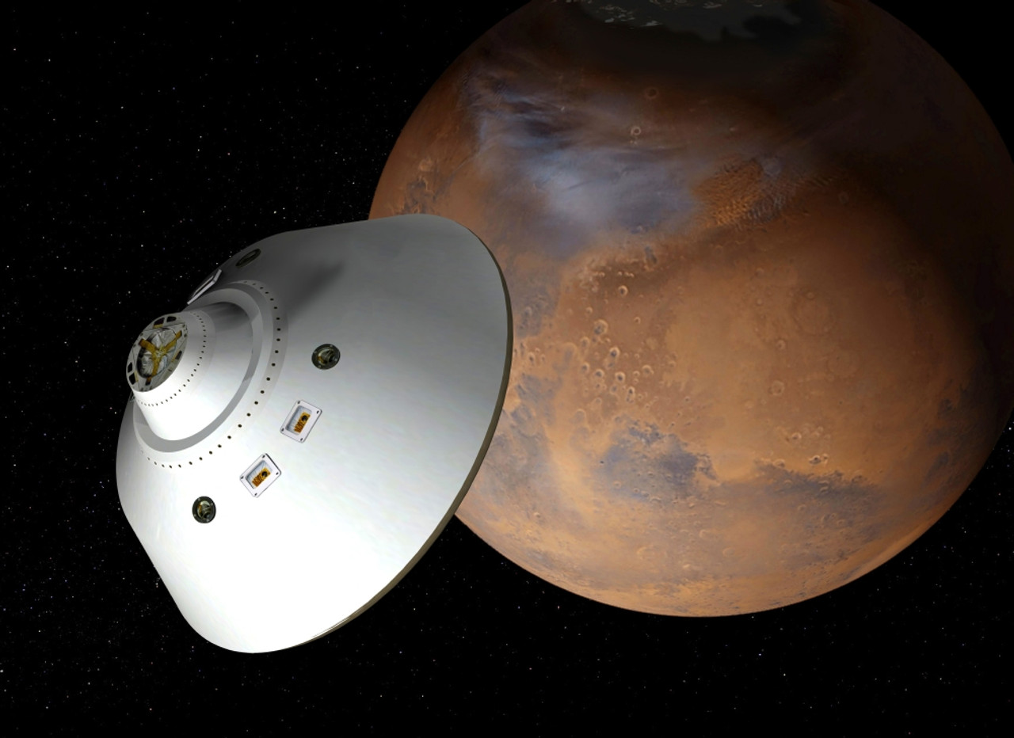
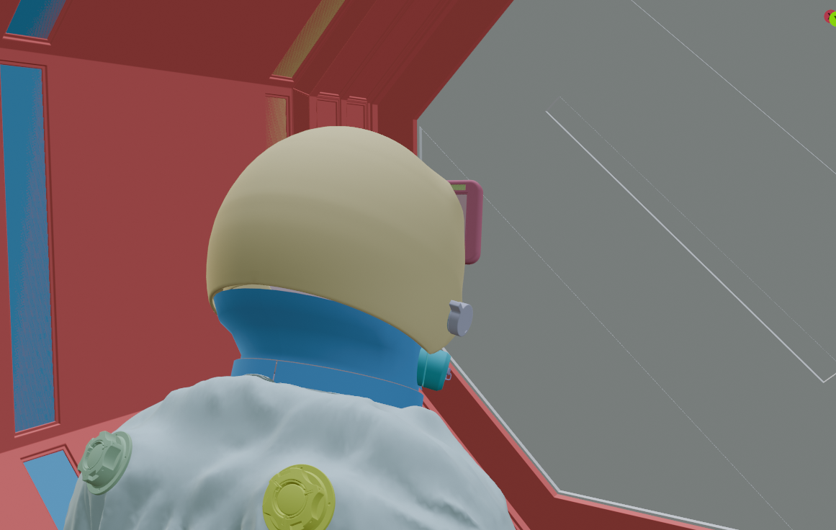

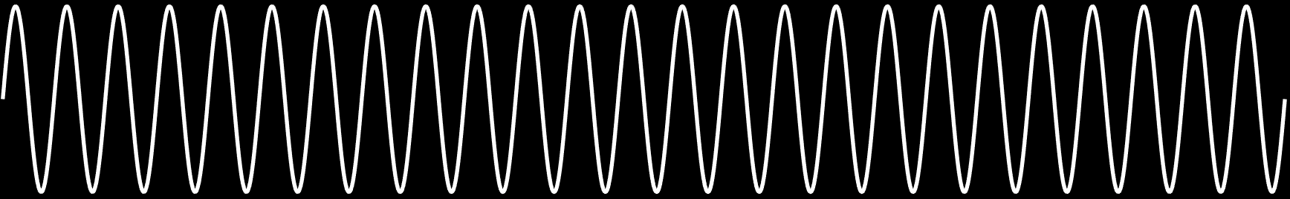
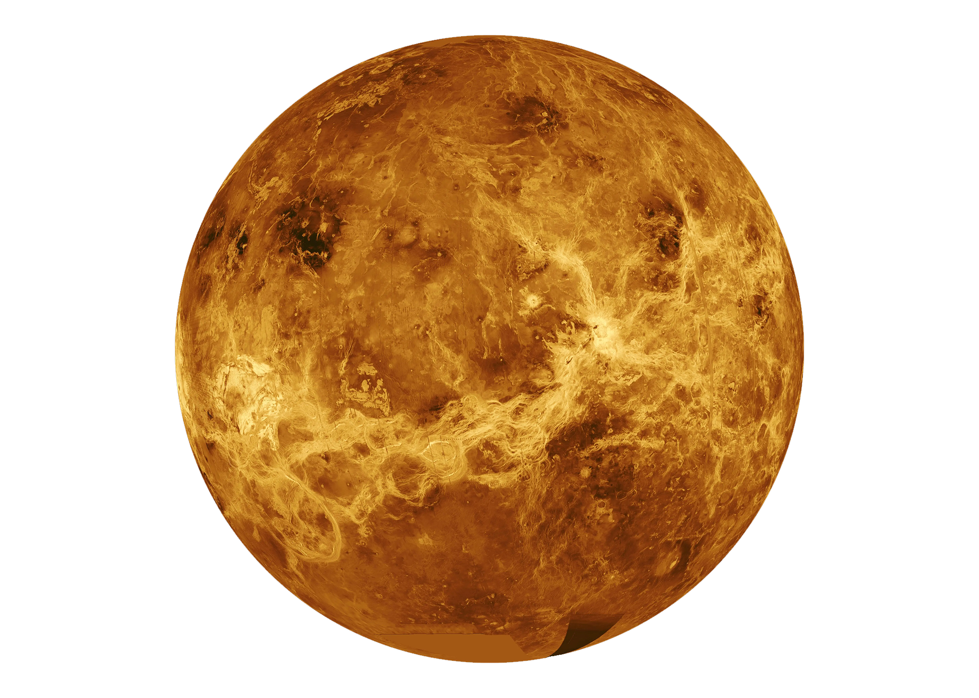
EDL – Entry Phase
1. Contact with crew to initiate cruise stage separation
2. Initiate and confirm "ready check" for scientific instruments (MARCI, TLS, MASPEX)
3. Initiate aeroshell’s atmospheric entry into Venus
Rene Holmes

Slide 24



EDL – Descent Phase
4. Monitor EDL sequence back shell and aeroshell separation
5. Initiate parachute and balloon deployment
6. Initiate parachute ejection and altitude adjustment
Rene Holmes

Slide 25


DITL (1/2)
1. Crew initiates systems check of scientific instruments (MARCI, TLS, MASPEX)
2. Crew monitors gondola location to perform science in predetermined locations
Everytime line-of-sight is acquired
Locations dependent on science return and wind pattern
3. Crew alternates altitude of the balloon based on the wind current
Crew will pressurize and depressurize the gondola to stay within the naturally occurring wind current
Rene Holmes

Slide 26
DITL (2/2)
4. Crew will maintain flight path of balloon at a constant altitude between 45 km – 55 km
5. Crew will oscillate balloon altitude to utilize the various science instruments aboard
6. Crew orders balloon to return to neutral flight before line of sight is lost
Rene Holmes
Notes:
Script
Mention the concept of the goldilocks zone in 5
We did a scale height analysis, where we utilizes the VIRA atmospheric model to determine the ideal altitude for our mission.

Slide 27

EDL – Landing Phase
7. Initiate and confirm "ready check" for scientific instrument seismometer (SEIS)
8. Outer balloon begins deflating to begin final descent
9. Touchdown at Alpha Regio and initiate SEIS data collection
Rene Holmes

Slide 28
Mission Profile
Rene Holmes

Slide 29


Parachute Properties
Parachute Parameters:
Total surface area: 1.17 $m^{2}$
Diameter: 0.86 m
Volume: 0.17 $m^{3}$
C_{d}: 2.2
Snatch force: 5861.31 N
Per shroud line
32 shroud lines total
Number of parachute: 1
Rene Holmes

Slide 30


Balloon Characteristics
Genesis Overview
Flight Mechanics Simulation and Trajectory Design Tool by NASA Johnson
Capable of modeling entry, descent, and landing trajectories
Characteristics of the system
Balloon begins inflation at: 82.2 minutes
Inflation gas: Hydrogen (Total weight of 91.62 kg)
Total cost: $646.1 of gas
Total weight (Gas and tank): 391.62 kg
Expected erosion: $6.43 x {10}^{−4}$ nm
Figure - Altitude vs. Time plot
Peter Ho

Slide 31



Balloon Material
From Outer to Inner
Aluminized Fluorinated Ethylene Propylene (FEP) Teflon film to prevent overheating
Mylar film to retain gas
Vectran Fabric to maintain structure
Polyurethane Coating for sealing the balloon section together
Erosion
The materials are resistant to erosion in Venus' 88-95% sulfuric acid atmosphere
FEP Teflon
Adhesive
Polyester film
Vectran fabric
100 denier 1-3-1 Ripstop weave
25 yams/cm warp x 25 yams/cm fill
58 $\frac{g}{m^{2}}$
Aliphatic Urethane
Courtesy:
NASA JPL
Peter Ho

Slide 32
Balloon Deployment RipStitches
Allows for the deployment of the balloon during parachute deployment
Source of shock from the upward force of the chute and downward force of the payload
RipStiches will dissipate the shock of extending the balloon
Main Chute
Main Chute
Force of chute
RipStiches
Rip apart
Balloon
Balloon
RipStiches
Weight of Payload
Payload
Payload
Peter Ho

Slide 33
Initial Outer Balloon Inflation
During descent, the tank gas release valve opens to release hydrogen gas from a gas tank regulated at 0.2006 MPa
Hydrogen mass flow rate of 478.42 kg/s for 0.192 seconds
Outer balloon volume of 1400 m³ at end of initial inflation to slow descent speed
Max lift acceleration of 1.25 m/s²
Total mass of hydrogen gas is 91.62 kg
Internal pressure of 0.2005 MPa
Under the tensile strength of 3200 MPa for Vectran so the balloon will not pop
Outer Gas Balloon
Inner Gas Balloon
Tank gas Release Valve
Gas Pump
Inner Balloon Gas Release Valve
Pressurized Gas Tank
Peter Ho

Slide 34
Inner Balloon Inflation for Level Flight
Outer Gas Balloon
To achieve level flight, the inner balloon must increase to a volume of 30 m³
The outer balloon will shrink to a volume of 1226.49 m³
Assuming a gas compressor with a rate of 0.023 m³ /s, inflation will take 78.26 minutes
Outer and inner balloon will have 80.27 kg and 11.35 kg of hydrogen respectively
Inner balloon pressure will be 1.16 mPa
Under the tensile strength of 3200 mPa for Vectran so the balloon will not pop
Inner Gas Balloon
Tank gas Release Valve
Gas Pump
Inner Balloon Gas Release Valve
Pressurized Gas Tank
Peter Ho

Slide 35
Altitude Control during mission
Deflation has the gas pump transfer gas from the outer balloon into the inner balloon
Inflation involves the inner balloon gas release valve opening to release high pressure gas stored in the inner balloon
Max upward acceleration of 1.25 m/s²
Max downward acceleration of 8.65 m/s²
Inflation is faster than deflation due to slow speed of pump compared to valves
Outer Gas Balloon
Inner Gas Balloon
Tank gas Release Valve
Gas Pump
Inner Balloon Gas Release Valve
Pressurized Gas Tank
Peter Ho

Slide 36

Access Report/ Link Budget
Access Report
Mean duration: 41.62 minutes
Total Duration: 624.25 minutes
Number of access per day: 15
Link Budget (Downlink/Uplink)
Carrier SNR achieved: 108.93 / 142.67 dB
Carrier link margin: 98.94 / 132.67 dB
Data symbol rate (E_{b}/N₀): -52.52 dB-Hz
SNR achieved: 84.27 / 118.01 dB
Data link margin: 79.77 / 113.51 dB
Eric Ruf
Notes:
Talk about Orbital parameters for both orbits
Highly inclined orbit (similar to a Molinya orbit)
Crew: 826 x 40176.6121 km
Payload: “Circular orbit” at 50km

Slide 37
Trade Studies
Eric Ruf

Slide 38
Gas Trade FOM
FOM # | Description | Target Value | Importance Rank | Weight Factor
1 | Total Mass for inflation (kg) | 100 | 4 | 1
2 | Density (kg/m³⁾ | 0.09 | 3 | 2
3 | Storage pressure (MPa) | 747 | 5 | 1
4 | Boiling Point (°C) | -270 < | 1 | 3
5 | Cost (US$/kg) | 0.08 | 2 | 2
Eric Ruf

Slide 39
Gas Trade Matrix Architectures
 | FOM | Weight | Hydrogen (UHP) | Helium (UHP) | Nitrogen (UHP)
Mass (kg) | 1 | 1 | 5.88 | 11.68 | 81.85
Density (kg/m³) | 2 | 2 | 0.09 | 0.18 | 1.25
Storage Pressure (MPa) | 3 | 1 | 70 | 33 | 40
Boiling Point (°C) | 4 | 3 | −268.93 | −252.88 | −195.80
Cost (US$/kg) | 5 | 2 | 3 | 24 | 0.14
UHP stands for Ultra high purity of about 99.99%
Eric Ruf

Slide 40
Gas Trade Matrix (1/2)
FOMs | Boiling Point (°C) |  |  |  | Cost (US$/kg) |  |  |  | Density (kg/m³)
Alternate Architectures | V > |  | -270 |  | V ≤ |  | 5 |  | V ≤ |  | 0.15
 | WF = |  | 3 |  | WF = |  | 2 |  | WF = |  | 2
 | V | U % | U | W | V | U% | U | W | V | U% | U | W
Hydrogen | -268.93 | -0.40 | 3 | 9 | 3 | 40 | 9 | 18 | 0.09 | 40.08 | 9 | 18
Helium | -252.87 | -6.34 | 5 | 15 | 24 | -380 | 0 | 0 | 0.18 | -19 | 5 | 10
Nitrogen | -195.79 | -27.49 | 9 | 27 | 0.14 | 97.2 | 9 | 18 | 1.25 | -733.73 | 0 | 0
Eric Ruf

Slide 41
Gas Trade Matrix (2/2)
FOMs | Total Mass (kg) |  |  |  | Storage Pressure (Mpa) |  |  |  | Weighted Totals (ΣW)
Alternate Architectures | V ≤ |  | 15 |  | V < |  | 747
 | WF = |  | 1 |  | WF = |  | 1
 | V | U% | U | W | V | U% | U | W
Hydrogen | 58.42 | -289.48 | 9 | 9 | 70 | 90.63 | 9 | 9 | 63
Helium | 116.03 | -673.50 | 5 | 5 | 33 | 95.58 | 9 | 9 | 39
Nitrogen | 812.89 | -5319.27 | 0 | 0 | 40 | 94.65 | 9 | 9 | 54
Eric Ruf

Slide 42
Parachute Trade Matrix FOM
FOM # | Description | Target Value | Importance Rank | Weight Factor
1 | Density (g/cm³) | 1.4 | 2 | 3
2 | Cost (US$/kg) | 25 | 5 | 1
3 | Elongation (%) | 3.5 | 4 | 4
4 | Tensile Strength (MPa) | 4,000 | 3 | 3
5 | Decomposition Temperature (°C) | 500 | 1 | 5
Eric Ruf

Slide 43
Parachute Material Architectures
 | FOM | Weight | Vectran-LCP | Kevlar | Zylon HM
Density (g/cm³) | 1 | 3 | 1.4 | 1.44 | 1.56
Cost (US$/kg) | 2 | 1 | 0.50 | 15.00 | 180.00
Elongation (%) | 3 | 4 | 3.3 | 3.6 | 3.5
Tensile Strength (MPa) | 4 | 3 | 1,100 | 3,600 | 5,800
Decomposition Temperature (°C) | 5 | 5 | 400 | 482 | 650
Eric Ruf

Slide 44
Parachute Material Trade Matrix (1/2)
FOMs | Density (g/cm^3) |  |  |  | Cost (US$/kg) |  |  |  | Elongation (%)
Alternate Architectures | V < |  | 1.4 |  | V ≤ |  | 25 |  | V ≤ |  | 3.5
 | WF = |  | 3 |  | WF = |  | 1 |  | WF = |  | 4
 | V | U % | U | W | V | U% | U | W | V | U% | U | W
Vectran-LCP | 1.40 | 0.00 | 3 | 9 | 0.5 | 98 | 9 | 9 | 3.30 | 5.71 | 5 | 20
Kevlar | 1.44 | 2.86 | 3 | 9 | 15 | 40 | 9 | 9 | 3.60 | -2.86 | 3 | 12
Zylon HM | 1.56 | 11.43 | 5 | 15 | 180 | -620 | 0 | 0 | 3.50 | 0.00 | 3 | 12
Eric Ruf

Slide 45
Parachute Material Trade Matrix (2/2)
FOMs | Tensile Strength (MPa) |  |  |  | Decomposition Temperature (°C) |  |  |  | Weighted Totals (ΣW)
Alternate Architectures | V ≤ |  | 4000 |  | V > |  | 500
 | WF = |  | 3 |  | WF = |  | 5
 | V | U% | U | W | V | U% | U | W
Vectran-LCP | 1100 | 72.50 | 9 | 27 | 400 | 20.00 | 5 | 25 | 90
Kevlar | 3600 | 10.00 | 5 | 15 | 482 | 3.60 | 5 | 25 | 70
Zylon HM | 5800 | -45.00 | 0 | 0 | 650 | -30.00 | 0 | 0 | 27
Eric Ruf

Slide 46

Finite Element Analysis – Aeroshell
Ansys Mechanical
Finite element solver with structural, thermal, acoustics, transient and nonlinear capabilities
Inputs:
Static Structural analysis
Aluminum Alloy
Pressure: 10 MPa
Gravity: 8.87 m/s
Results
Maximum Equivalent Stress: 8,729,000 Pa = 8.729 MPa
Minimum Equivalent Stress: 3685.9 Pa
Harold Hernandez

Slide 47
Mass & Power
Harold Hernandez

Slide 48
Aeroshell with Payload Mass Statement (1/2)
Aeroshell with Payload Mass Statement
Subsystem | Budget (kg) | Current (kg) | Status
Payload | 565.50 | 3206.46 | C
Structure | 260.00 | 575.00 | C
Thermal Control | 1378.00 | 440.00 | C
Power | 195.00 | 304.81 | C
TT&C | 91.00 | 16.06 | C
On-Board Processing | 52.00 | 7.07 | C
ADC | 78.00 | 2.98 | C
Propulsion | 130.00 | 67.27 | C
Other (balance + launch) | 39.00 | 21.00 | C
Cables | 0.00 | 310.99 | C
Budget Total | 2788.50 | 4573.37 | C
Margin | 975.98 | -1187.16 | C
Harold Hernandez
Notes:
Add the tanks

Slide 49
Aeroshell with Payload Mass Statement (2/2)
Aeroshell with Payload Mass Statement
Subsystem | Budget (kg) | Current (kg) | Status
On-Orbit Dry | 2788.50 | 4573.37 | C
Propellant | 1430.00 | 1579.29 | C
Pressurant | 6.40 | 7.07 | C
On-Orbit Wet | 4218.50 | 6152.66 | C
Adapter | 368.50 | 514.53 | C
Launch Mass | 4587.00 | 7045.45 | C
Harold Hernandez

Slide 50
Balloon System Mass Statement (1/2)
Balloon System Mass Statement
Subsystem | Budget (kg) | Current (kg) | Status
Payload | 312.00 | 77.43 | C
Structure | 260.00 | 1890.11 | C
Thermal Control | 1378.00 | 120.00 | C
Power | 130.00 | 152.41 | C
TT&C | 91.00 | 8.39 | C
On-Board Processing | 52.00 | 3.91 | C
ADC | 78.00 | 5.83 | C
Propulsion | 104.00 | 0.00 | C
Balloon Related | 195.00 | 502.27 | C
Cables | 0.00 | 187.70 | C
Budget Total | 2600.00 | 2760.35 | C
Margin | 910.00 | 749.65 | C
Harold Hernandez
Notes:
Add the tanks

Slide 51
Balloon System Mass Statement (2/2)
Balloon System Mass Statement
Subsystem | Budget (kg) | Current (kg) | Status
On-Orbit Dry | 2600.00 | 2760.35 | C
Propellant | 1430.00 | 0.00 | C
Pressurant | 6.40 | 0.00 | C
On-Orbit Wet | 4030.00 | 2760.35 | C
Adapter | 354.27 | 258.41 | C
Launch Mass | 4384.27 | 3206.46 | C
Harold Hernandez

Slide 52
Aeroshell Power Statement
Spacecraft Power Statement
Subsystem | Budget (W) | Current (W) | Status
Thermal Control | 92.81 | 14.14 | C
Attitude Control | 66.29 | 208.39 | C
Power | 33.15 | 200.54 | C
C&DS | 92.81 | 91.00 | C
COMMs | 43.09 | 258.80 | C
Propulsion | 3.31 | 2.42 | C
Total | 331.45 | 775.29 | C
Margin | 298.31 | -145.54 | C
On orbit power | 331.45 | 775.29 | C
Alejandro Wuence

Slide 53
Gondola Power Statement
Spacecraft Power Statement
Subsystem | Budget (W) | Current (W) | Status
Thermal Control | 157.42 | 75.00 | C
Attitude Control | 112.44 | 92.04 | C
Power | 56.22 | 217.65 | C
C&DS | 95.58 | 86.00 | C
COMMs | 73.09 | 159.60 | C
Balloon System | 67.47 | 375.00 | C
Total | 562.22 | 1005.29 | C
Margin | 506.00 | 62.93 | C
Payload | 200.00 | 125.50 | C
On orbit power | 531.45 | 1130.79 | C
Alejandro Wuence

Slide 54
Cost Statement
Total Cost Table
Cost Model | *Total Cost (2010) | *Total Cost (2023) | *Total Cost (2035)
USCM8 (Non-recurring) | 222 | 314 | 398
USCM8 (Recurring) | 313 | 442 | 561
Software | 2.39 | 3.37 | 4.27
Total | 629 | 760 | 963
* Cost in millions of dollars
Alejandro Wuence

Slide 55
Compliance Matrix (1/3)
ID | Requirement Description | Explanation | Complies? | Section
RFP-1 | Design a scientific mission aimed at maximizing scientific returns from Venus with a manned crew in orbit. | The crew can will have complete control over the scientific spacecraft | Yes | ConOps and DITL
RFP-2 | Clearly define science objectives and compare the added benefit of a crewed science mission as opposed to a fully autonomous mission. | The “goldilocks zone” will be the focus of the scientific mission and the crew will have in real time reaction to the turbulent weather | Yes | Mission Overview and DITL
RFP-3 | Describe all aspects of the scientific mission including the approach to collecting data. | The scientific spacecraft will use a gas analyzer to determine exact gas composition and detect seismographic waves | Yes | DITL Instrument Uses
RFP-4 | Provide a detailed description of the crew-to-scientific spacecraft interaction | The crew communicates over S-Band with the scientific vehicle | Yes | DITL Crew Interactions
Alejandro Wuence

Slide 56
Compliance Matrix (2/3)
ID | Requirement Description | Explanation | Complies? | Section
RFP-5 | Completely describe the spacecraft’s operation from launch to end of life | The scientific vehicle will cycle between 45 and 55 km recording data until the end of the 30-day mission duration after which it’ll land on Alpha Regio | Yes | Trajectory and DITL
RFP-6 | Operation with crew in the loop last no more than 30 Earth days | The crew should begin and finish all operations with the spacecraft on January 17th, 2036, and February 16th, 2036, respectively | Yes | Mission Overview
RFP-7 | Trade studies at system and subsystem level to demonstrate fitness of the chosen vehicle design including benefit, risk, and cost | Mass, power, and cost statements along with budget allocated for each subsystem | Yes | Sys. Eng.
RFP-8 | Team display in-depth communication analysis including necessary orbital mechanics parameters | Communication analysis and trade studies for all the components | Yes | Access Report and Link Budget
RFP-9 | Team must describe any specialized equipment, instrument, or other system needed to enable the necessary science return. | Concise description and justification for all specialized equipment or systems essential for the project's scientific objectives, detailing their roles, capabilities, and technical specifications. | Yes | DITL Instrument Uses
Alejandro Wuence

Slide 57
Compliance Matrix (3/3)
ID | Requirement Description | Explanation | Complies? | Section
RFP-10 | Discuss selection of subsystem components and associated values, while describing how requirements drove selection of subsystem. | Each design drivers were evaluated within each subsystem section. | Yes | Balloon System Design
RFP-11 | Launch for the mission shall be no later than December 31, 2037 | The departure date for the spacecraft is July 1st, 2035, and an arrival date of January 17th, 2036 | Yes | Trajectory
RFP-12 | The mission shall be completed no later than December 31, 2039, lasting no longer than 30 Earth days | The mission has a targeted finish of February 16th, 2036 | Yes | Trajectory
Alejandro Wuence

Slide 58
Conclusion
Mission Overview
Conducting near-surface Venus mission using a balloon system with a crew-in-the-loop
Obtaining weather data, atmospheric composition, wind data, and seismic waves
Expected Cost: $760 million (2023)
Spacecraft Budgets
Total spacecraft mass: 7045.45 kg (34.89 % over budget)
Within Vulcan VC6 payload mass capacity of 9,205 kg
Total spacecraft power: 1906.08 W (54.7% over budget)
Michael Quach
Notes:
Design A
Total time = 302.74 days
Total DV = 17.74 km/s
Design B
Total time = 292.14 days
Total DV = 13.3141 km/s

Slide 59
Reference Slide
[1] Brown, C. D. (2002). Elements of spacecraft design. American Institute of Aeronautics and Astronautics, Inc.
[2] Edberg, D. (2022). Spacecraft Design, Development, & Operation.
[3] Europa Clipper Instrument Summaries. (n.d.-a). https://europa.nasa.gov/internal_resources/379/ScienceInstruments_031422_Public.pdf
[4] Instructions for competitors obtaining own launch RevB - NASA. (n.d.-b). https://www.nasa.gov/wp-content/uploads/2023/02/instructions-for-competitors-obtaining-own-launch-revb.pdf
[5] NASA. (n.d.-a). Artemis. NASA. https://www.nasa.gov/specials/artemis/
[6] NASA. (n.d.). JPL’s Venus Aerial Robotic Balloon Prototype Aces test flights. NASA. https://www.jpl.nasa.gov/news/jpls-venus-aerial-robotic-balloon-prototype-aces-test-flights?
[7] NASA. (2023, February 16). Maspex. NASA. https://europa.nasa.gov/spacecraft/instruments/maspex/
[8] NASA. (n.d.-b). NASA Technical Reports Server (NTRS). NASA. https://ntrs.nasa.gov/
Michael Quach

Slide 60
Reference Slide
[9] NASA. (n.d.-b). Radar Imager for mars’ subsurface exploration (RIMFAX). NASA. https://mars.nasa.gov/mars2020/spacecraft/instruments/rimfax/
[10] Space mission engineering: The new smad. (2011). . Amazon Publishing.
[11] Wikimedia Foundation. (2023, October 5). Xenon. Wikipedia. https://en.wikipedia.org/wiki/Xenon
[12] Wikimedia Foundation. (2023a, October 1). Psyche (spacecraft). Wikipedia. https://en.wikipedia.org/wiki/Psyche_(spacecraft)
[13] Wong, Dale. RE/MAX, Southern California Balloon Program Coordinator
[14] https://www.globalspec.com/learnmore/specialized_industrial_products/transportation_products/parachutes
[15] J.L. Hall, et. all (2007, March 7). https://www.sciencedirect.com/science/article/pii/S0273117707002360#aep-section-id22
[16] https://www.matweb.com/search/DataSheet.aspx?MatGUID=8552ae3f68e8401483d0641b8244792e&ckck=1
[17] Erwin, H. (1961). Arizona. University of Arizona University Libraries. https://repository.arizona.edu/bitstream/handle/10150/319350/AZU_TD_BOX20_E9791_1961_26.pdf;sequence=1
Michael Quach

Slide 61
Reference Slide
[18] Slide 17 SAM for Scientists | SAM – NASA Mars Exploration
[19] Venus's planet information explanet.info/Chapter07.htm
[20] Aeroshell Image Slides 12-13 3645_PIA14833-full2.jpg (2500×1406) (nasa.gov)
[21] Aeroshell & Venus slide 13 PSTSTK203811SLARGE__64699.1541914799.jpg (1280×932) (bigcommerce.com)
[22] Backshell image slide 12 backshell-web.jpg (1280×720) (nasa.gov)
Michael Quach

Slide 62

Thank you!
Michael Quach

Slide 63
Back-up Slides

Slide 64

MERV GitHub
GitHub Link
https://github.com/DraitonT/MERV
Tools Utilized
Structures: SolidWorks, Ansys Mechanical, Blender
Orbital Mechanics: MATLAB, Python, Julia, Genesis
Communications: Ansys Systems Tool Kit (STK)
GitHub QR Code

Slide 65


ACS
Overview
Number of thrusters: 8 in total (4 for aeroshell)
Atmospheric perturbations are the most significant
~150 seconds for each rotation to reach 180 degrees
Worst Case Scenarios (@ 180 Degrees)
$T_{Atmospheric}$ = [7.06, 7.52, 7.61] N-m
$T_{Gravity gradient}$ = [-0.46, -0.50, -0.51] x ${10}^{−5}$ N-m
$T_{Solar Radiation}$ = [5.96, 1.66, 1.66] x ${10}^{−5}$ N-m
$T_{Magnetic}$ = [0, 0, 0] N-m
Thruster (Green propellant)
1N HPGP from ECAPS
ISP: 231 seconds
Notes:
Design A
Total time = 302.74 days
Total DV = 17.74 km/s
Design B
Total time = 292.14 days
Total DV = 13.3141 km/s

Slide 66



Characteristics of the Flight (1/2)
Figure - Pressure vs. Time
Figure – Altitude vs Velocity
Figure - Temperature vs. Time

Slide 67



Characteristics of the Flight (2/2)
Figure - Lift force vs. Time
Figure – Snatch force vs. Time
Figure – Scale Height vs. Altitude vs. Time

Slide 68






*ConOps Diagram (Crew Module)
Transfer Time: 160 days
Earth Departure
August 9th, 2035
Venus Arrival
January 16th, 2036
(1) SLS enters parking orbit
(2) Crew module detaches from SLS
(9) Crew module reenters into Earth
(8) Crew module attaches and leaves from Gateway
(7) Crew module leaves Venus
(3) Crew module docks onto Gateway
(4) Crew module leaves Gateway to Venus
(6) Crew module establishes COMMs with the orbiter
Mission conducted
(5) Venus Orbit insertion
* Crew mission is out-of-scope as defined by AIAA RFP
Notes:
Script
We’re stopping at Gateway, they’re stopping to refill on any supplies, crew health check, and more before the long trip to Venus. Instead of going all the way to Venus at once.

Slide 69

Finite Element Analysis of Aeroshell - Static
Ansys Mechanical
Finite element solver with structural, thermal, acoustics, transient and nonlinear capabilities
Inputs:
Static Structural analysis
Aluminum Alloy
Pressure: 10 MPa
Gravity: 8.87 m/s
Results
Maximum Equivalent Stress: 1942.9 Pa
Minimum Equivalent Stress: 12.951 Pa

Slide 70

Finite Element Analysis of Aeroshell
Inputs:
Dynamic Structural analysis
Aluminum Alloy
Velocity: 6,000 m/s
Pressure: 10 MPa
Gravity: 8.87 m/s
Results
Maximum Equivalent Stress: 217270 Pa = 0.21727 MPa
Minimum Equivalent Stress: 1765.7 Pa
Notes:
General aluminum alloy compressive yield strength of 280 MPa (preprogrammed)

Slide 71


Scientific Instruments CAD (1/4)
0.21 meters
0.1
meters
Y
TLS (Tunable Laser Spectrometer)
Z

Slide 72


Scientific Instruments CAD (2/4)
1.0 m
0.5 m
Y
MASPEX (MAss Spectrometer for Planetary EXploration)
Z

Slide 73


Scientific Instruments CAD (3/4)
0.3 m
0.18 m
Y
SEIS (Seismic Experiment for Interior Structure)
Z

Slide 74


Scientific Instruments CAD (4/4)
0.1 m
0.1 m
Y
MARCI (Mars Color Imager)
Z

Slide 75

Gantt Chart - Tasks (1/4)

Slide 76

Gantt Chart - Tasks (2/4)

Slide 77

Gantt Chart - Tasks (3/4)

Slide 78

Gantt Chart - Tasks (4/4)

